Slide 1
Academic Partnerships across the Defence Ecosystem to Accelerate Innovation
Heather Goldstraw
Director of Strategic Relationships - Defence & Security
27 Feb 2026

Slide 2
The Defence Ecosystem
In a complex, operational and safety critical enterprise such as Defence, the major organisations are the Users, Investors/Procurers, Industrial Supply Chain, and Regulator.
Every one of these communities is connected to every other – not always helpfully!
User Communities
Defence & Security Forces in UK and Allied Nations
Investment & Procurement organisations
Government Departments, Export clients
P3M, Commercial, Finance & Approvals experts
Research & Knowledge Creators
Academic institutions and RTOs
Educators
Industrial Supply Chain
System Integrators to Component manufacturers
Primes to SMEs, Traditional and New Entrants
Compliance System
Regulation, Standard & Policy makers
Test houses and Acceptance authorities
Academia forms the foundation that the Defence Ecosystem is built on.
Fundamentally we deliver both the Technology “sparks” and the People “engines”.

Slide 3
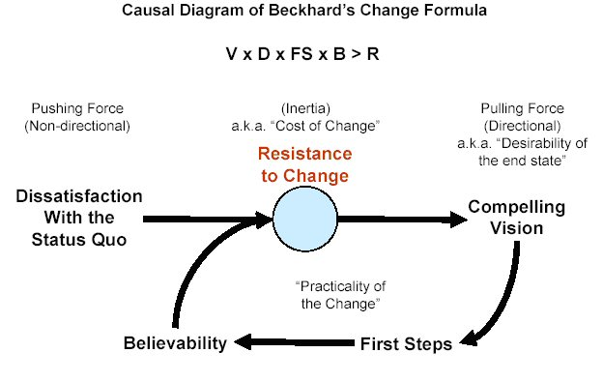
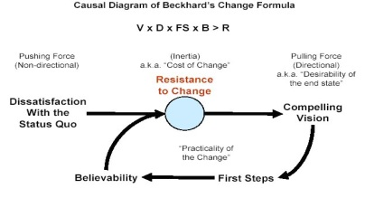
The Innovation Challenge - Ecosystem Readiness
Ensuring simultaneous, coherent Business Readiness across multiple organisations can require potentially disruptive change involving both technology and culture.
Any organisation can halt innovation – either intentionally or unintentionally.
Failing to deliver these simultaneous organisational changes is the reason most ideas fail in the technology “Valley of Death”
User
  Traditional defence suppliers may resist new entrants to the market or supply chain by withholding vital information on architectures or interfaces.
  Innovative SMEs or inventors may not be interested in supplying to Defence or not able to scale up or meet challenging security, resilience or interoperability standards or other supply chain expectations.
  Regulators may lack the evidence base and confidence to accept new technologies.
  Users may lack training capacity, forces structures, doctrine or information systems.
  Investors will have competing demands for finite funds and resources.
Supplier
Regulator
Notes:
The previous steps can be recognised as difficult with potentially significant time and cost commitments, but the key step in achieving successful innovation is to ensure the whole system has the confidence and capacity, in coherent timeframes, to actually make the required individual business investments and, potentially, transformational decisions.
The main reasons that most ideas or technologies, particularly the more radical or disruptive ones, fail to realise the benefits MOD may anticipate is that a key player or community in the overall enterprise does not see a sufficiently compelling business benefit or need for them to change and are in a position to prevent or delay progress as a result.
Illustrations:
Incumbent suppliers are able to prohibitively price the integration of a new technology that might adversely affect current support and profit models and forecasts.
An innovative SMEs may not prioritise Defence or cannot readily scale up or meet the security or quality standards to meet our requirements.
Regulators may not have sufficient confidence or evidence to accept the new technology or approach.
Promising S&T is unable to overcome either the technical or economic obstacles of transitioning to a viable product for integration into legacy environments.
Disruption to wider Lines of Development is not affordable or has unacceptable consequences on the wider military system.

Slide 4
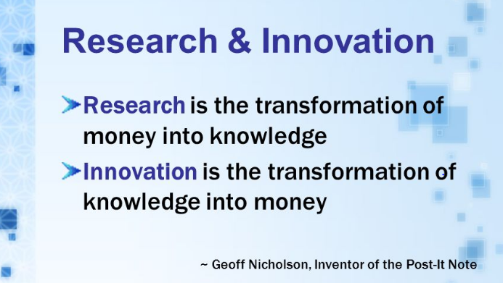
The Path to Innovation
Innovation or Capability Readiness: Realising the benefit of a new idea or technology requires…
Ecosystem Readiness: All the connected organisations within an ecosystem or enterprise are prepared and ready to implement the changes necessary to adopt a technology or idea, which requires...
System & Business Readiness: Each investment authority within a connected organisation to approve the Business Case to deliver the changes they need to enable a new idea or technology.
Technology Readiness: The spark for change often comes from research that leads to a technological breakthrough or transformational process improvement.
Governments and Industries invest in research to solve major problems or identify new opportunities.
They also need to invest in System, Business and Ecosystem Readiness.
Notes:
This terminology seeks to clearly differentiate between ‘Invention’ and ‘Innovation’ and has been developed by DE&S with members of the DSF subgroup on Research, Technology & Innovation and endorsed by key Innovation thought leaders including Professor Gann, a NED on the Min DP chaired Research, Technology & Innovation Board (RTIB).
The DSF community is working to ensure this model is widely promulgated, but there continues to be a significant mindset across the policy communities that Innovation correlates predominantly with S&T. At the recent Innovation Stocktake conducted by Will Jessett on 3rd Feb 17, concerns were raised by RAdml Fraser, Richard Berthon, and DE&S that this mindset risked the Innovation Initiative ‘missing’ the bulk of the Defence Budget. The issue was acknowledged and will be explored further under the work of the new Interim Innovation Director, due to arrive shortly.

Slide 5
Academic partnerships can catalyse & accelerate Innovation through Research and Human Capital Development.

Slide 6
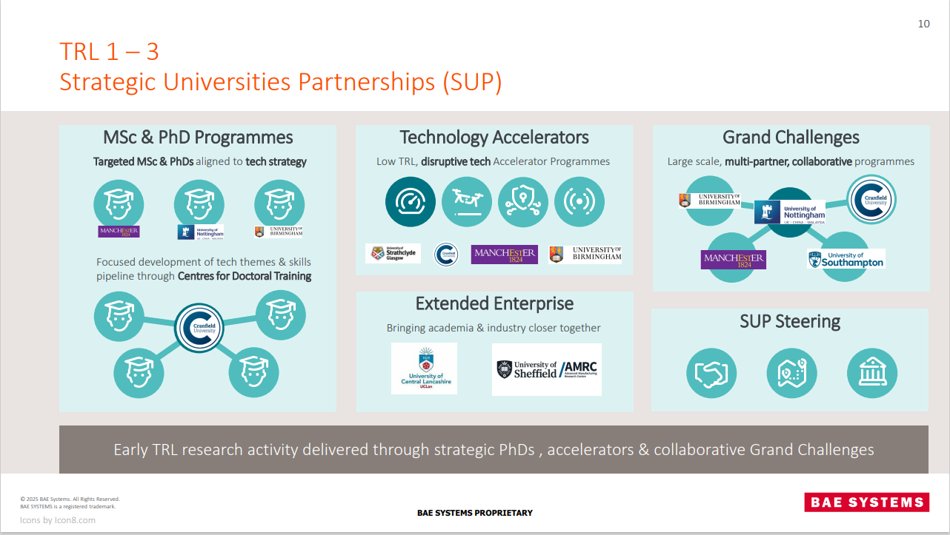
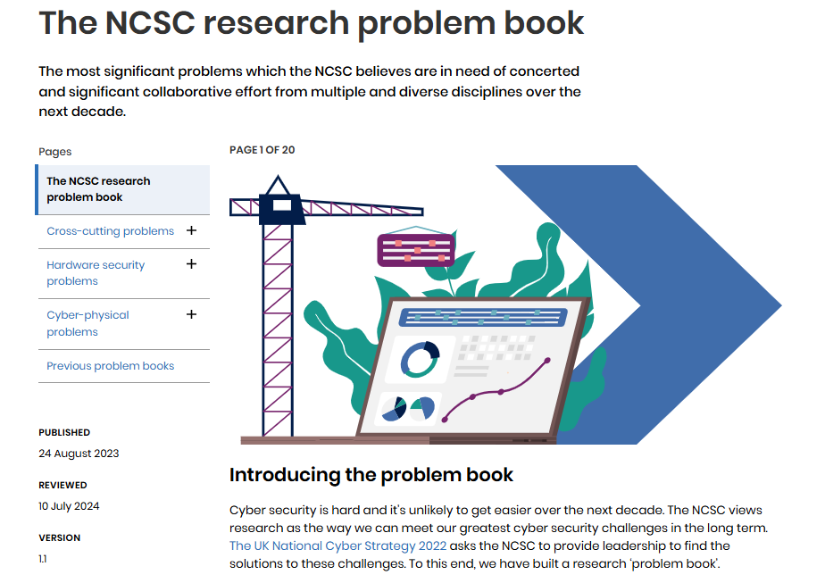
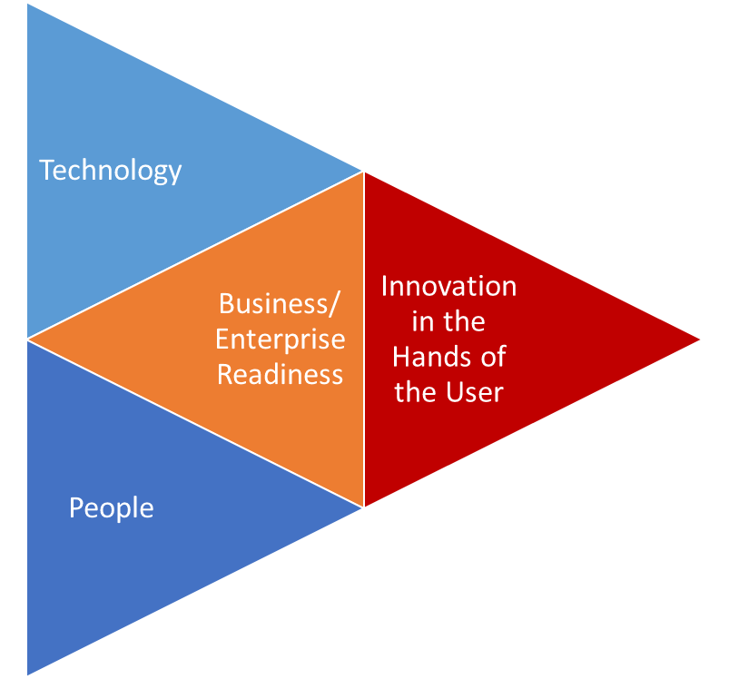
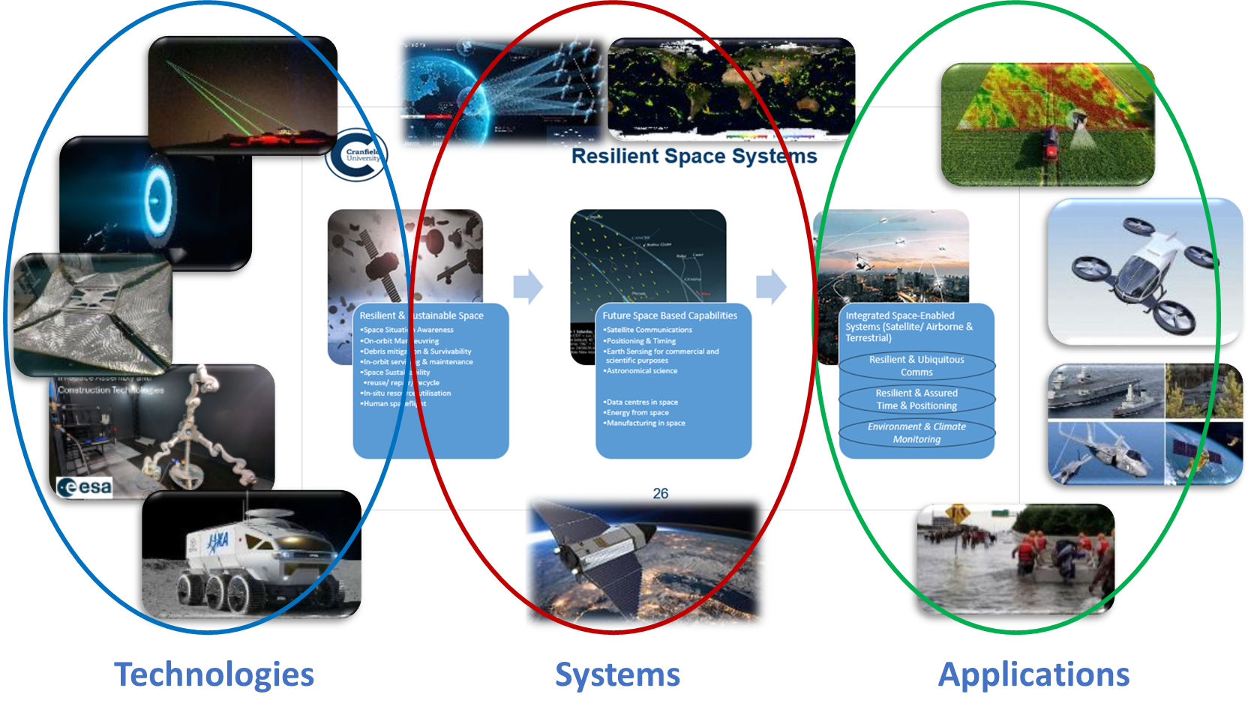
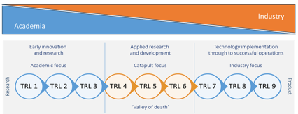
Research & Technology Development
Driven by client Problem Books, ‘Grand Challenges’ and Component, System or Process improvements

Slide 7
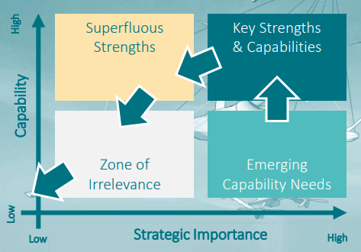
Human Capital Development
Building individual and organisational Knowledge, Skills, Experience and Behaviours
Professional skills
Technical skills and product development
Business & Enterprise Leadership
  Sustaining the core skills whilst developing the future strengths.
  Systems thinking approach and
  Cross-organisational / Cross-ecosystem learning and insights

Slide 8
Differing Perspectives on Education in HCD
Academic View
Governed by Education professional standards and regulations
Business View
Governed by Industrial professional standards and regulations
Focus on Higher Education product set
Culturally biased towards ‘long courses’
Culturally biased against ‘long courses’
Product/Manufacturing or professional service product set
Personal development offer aims to improve recruitment, performance and retention
Training/education is a cost/overhead
Training/education is a revenue stream
Personal development offer is a transaction
Prioritises achievement of learning outcomes
Prioritises achievement of business performance outcomes

Slide 9
Changing Approach from Academia
Module
Proof of Learning
Qualification
SC
EPA
L6 Apprenticeship
SCfC
L7 Apprenticeship
SCfC
Publication track record
MRes
Masterclass
Thesis
EngD
SC
MSc
Research deliverable
PhD
SCfC
SCfC
Consultancy deliverable
MA
MBA
The module becomes the primary education component.
Cohort design becomes as important as curriculum design.
Business clients can leverage other investments or income streams (e.g. research projects) to support staff to achieve recognised major qualifications.

Slide 10
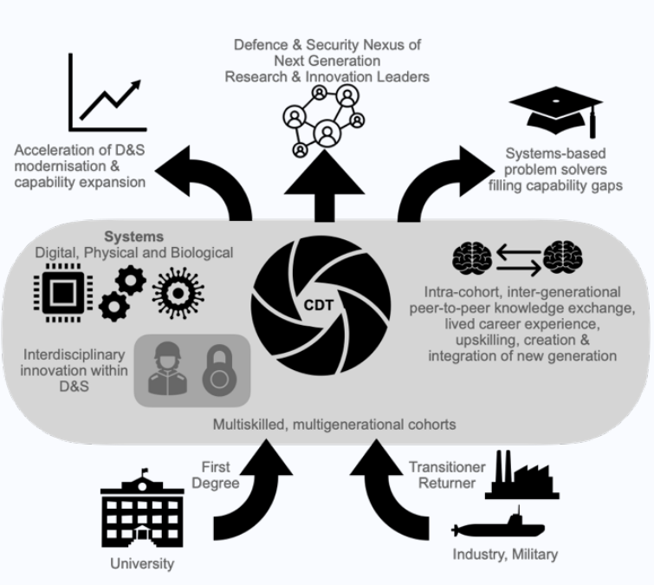
Centres for Integrated, Multi-Disciplinary Research & Education – the CDT Model
Focused topics or capability areas (e.g. Hypersonic Systems).
Annual cohorts of multidisciplinary researchers (currently PhDs but could be broadened) representative of the ecosystem (government departments, military specialists, industry supply chain, regulatory bodies etc.).
Common education injects that build system readiness, inter-personal and inter-organisational knowledge and relationships that will support cultural alignment in the near and longer term.

Slide 11
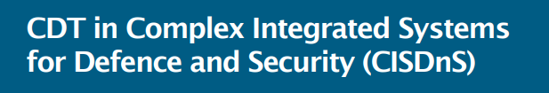

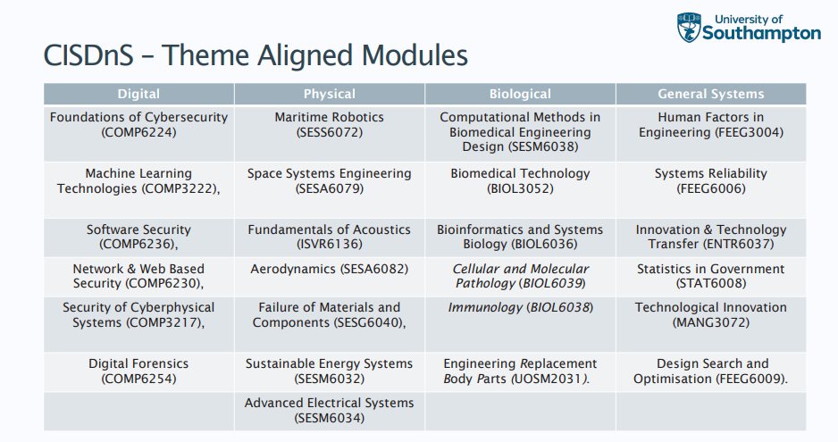
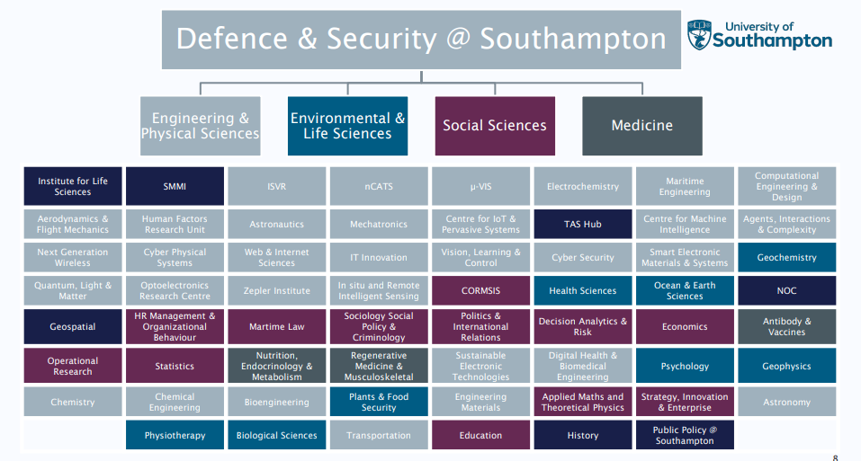
CDT Case Study

Slide 12
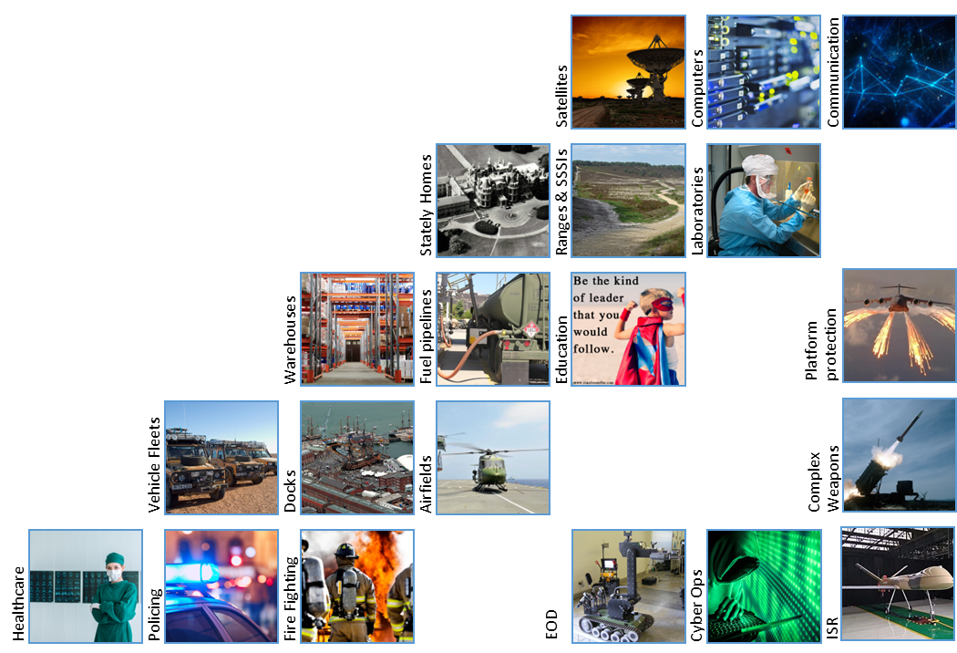
Cross-sector “CDT” opportunities
At Cranfield, Defence work is carried out across all our business areas that could generate “dual use” CDTs:
Aerospace & Aviation
AI, Robotics & Space
Energy & Transport
Manufacturing & Materials
Environment & Water
Logistics & Supply Chain
Leadership & Organisation Design
We also have a specialist
Defence & Security Theme that focuses
on those capabilities that are
unique or restricted:
Combat Systems
Electronic Warfare
CBRN

Slide 13

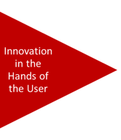
Innovation Readiness
Everything, everywhere, all at once... in a digital world.

Slide 14
Contribution of Academia to Innovation
Key Take Aways
Innovation is about managing complex change across whole ecosystems, and the cultural challenges are often bigger than the technological ones.
If Technology is the spark, People are the engine.
Multi-disciplinary, multi-organisational learning and research/development is key to reducing the cultural barriers to ecosystem effectiveness and so to successful innovation.
“Technology, Brilliantly Applied” highlights the integration of our Science, Engineering and Management Schools
Academia is the foundation of our ecosystems, and research driven education is essential to national technological and cultural evolution/revolution...
But, the foundation is crumbling and you are still prioritising the decorating!

