Slide 1

Harnessing ‘triple-helix’ collaboration for innovation in decision advantage
CDAO Defence, London
27 January 2026

Slide 2

Decision Advantage
Cognitive Clarity
In today’s contested and digital world, achieving Decision Advantage is hard and getting harder
To make and implement decisions better than an adversary means re-imagining decision-making
Data & Insight
Digital Enablement
Organisational Agility
Ethical Integrity
Notes:
To make and implement decisions better than an adversary - faster, more efficiently, with greater confidence and under greater uncertainty - requires us to re-imagine decision-making

Slide 3

Harder than ever
Higher volatility and complex systems
Data-rich environments still produce “decision-poor” outcomes
AI increases speed, but also increases risk of poor automation
Competing goals, constraints, ethics, governance
Trust, accountability, and legitimacy matter more than ever
Notes:
To make and implement decisions better than an adversary - faster, more efficiently, with greater confidence and under greater uncertainty - requires us to re-imagine decision-making

Slide 4
We need to re-imagine decision-making
means...
handling increasing complexity
thinking probabilistically
avoiding biases
all at increased pace
Cognitive Clarity
Data & Insight
Digital Enablement
Organisational Agility
Ethical Integrity

Slide 5
We need to re-imagine decision-making
means...
handling diverse data sources
getting from data to insights quicker
improving data literacy
enhancing data fusion,
management of trust, visualisation
Cognitive Clarity
Data & Insight
Digital Enablement
Organisational Agility
Ethical Integrity

Slide 6
We need to re-imagine decision-making
means...
getting more from what we have
augmenting human cognition
human/machine teaming
using digital twins
explainable AI
Cognitive Clarity
Data & Insight
Digital Enablement
Organisational Agility
Ethical Integrity

Slide 7
We need to re-imagine decision-making
means...
maximising the team
valuing diversity of view
enabling the edge
embedding transparency
Cognitive Clarity
Data & Insight
Digital Enablement
Organisational Agility
Ethical Integrity
Notes:
Enabling the edge = or mission command

Slide 8
We need to re-imagine decision-making
means...
assuring decisions differently
new legal and ethical frameworks
cyber resilience
Cognitive Clarity
Data & Insight
Digital Enablement
Organisational Agility
Ethical Integrity

Slide 9

Triple Helix

Slide 10
Triple Helix
A collaboration model for innovation which combines
Academia: academic mindsets, expertise, new knowledge creation
Industry: development and commercialisation
Government: enabling conditions, regulation, adoption pathways
…. And in defence, direct customer/demander
Notes:
To make and implement decisions better than an adversary - faster, more efficiently, with greater confidence and under greater uncertainty - requires us to re-imagine decision-making

Slide 11
A good fit because ….
Decision Advantage mission needs both:
technical capability
data, modelling, AI, decision science
socio-organisational capability
trust, governance, workflows, incentives
Notes:
To make and implement decisions better than an adversary - faster, more efficiently, with greater confidence and under greater uncertainty - requires us to re-imagine decision-making

Slide 12
A good fit because ….
Research to Practice translation
Standards, governance, assurance and evaluation mechanisms
Informed approaches to using AI
Cross-sector, cross supply chain learning loops
Triple Helix collaboration delivers:
Notes:
To make and implement decisions better than an adversary - faster, more efficiently, with greater confidence and under greater uncertainty - requires us to re-imagine decision-making

Slide 13
So triple-helix collaboration is attractive not because it gives us more innovation, but because it gives us better innovation conditions

Slide 14

Case Study

Slide 15
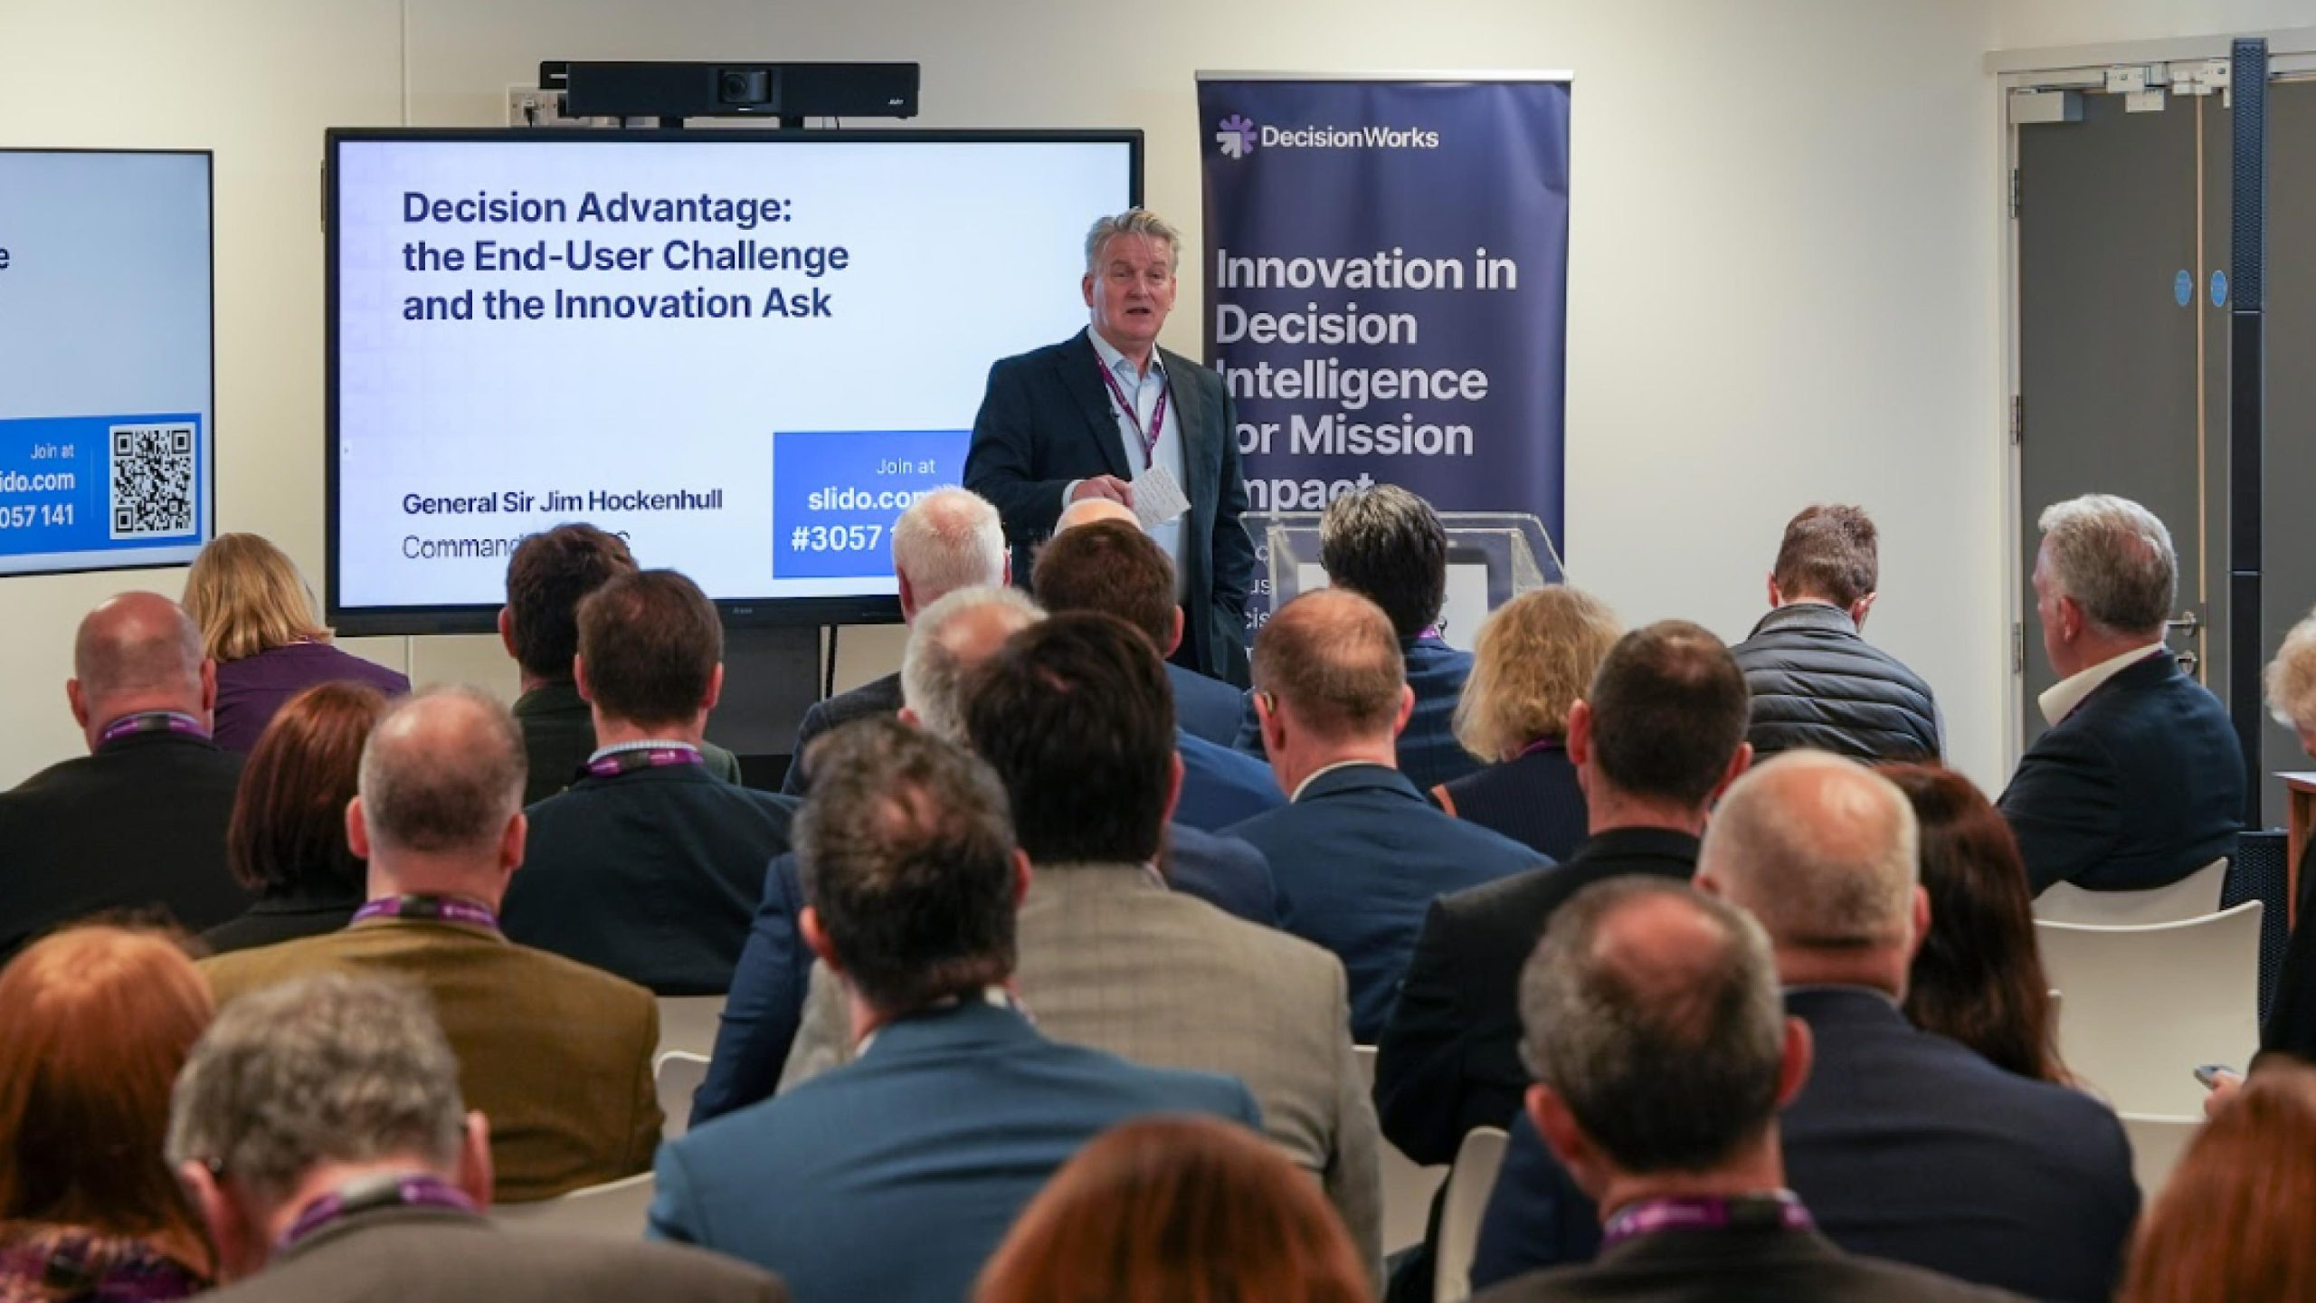

Slide 16



Intent
A new kind of collaborative innovation engine
ready to work at pace with UK Defence
to re-imagine decision-making for the digital age
Information
Advantage
Decision
Advantage
Mission
Advantage

Slide 17

A new kind of collaborative innovation engine
A direct response to external realities
and to SDR, DIS and wider Government policy
University Led
UK Sovereign
‘Triple-Helix’
Lincolnshire-flavoured

Slide 18
A new kind of collaborative innovation engine
A direct response to external realities
and to SDR, DIS and wider Government policy
Mission-driven
Decision expertise
Dual-use
Digitally enabled

Slide 19

A new kind of collaborative innovation engine
A direct response to external realities
and to SDR, DIS and wider Government policy
Motivated by profit
Just another product company
Just another AI company
An exclusive club

Slide 20

Founded by 4, Open to More

Slide 21


Founded by 4, Open to More
100% committed to Defence
Top tier for military education
Excellence in AI for Agri-Food Tech
Multidisciplinary academic reach
Cutting-edge Decision Intelligence software
UK founded, invested by HM Government
Dual-Use heritage through Financial Services
Open, explainable and flexible technology

Slide 22


Founded by 4, Open to More
Experts in OSINT, EW and defence data
Founded on a not-for-profit ethos
Novel and innovative software solutions
Enabled by SME responsiveness and agility
Decision expertise in depth
Technology agnostic and keen focus on collaboration
Securing and scaling capability
Integration and assurance services for
operational advantage

Slide 23




Founded by 4, Open to More
United by shared purpose
Agreed values and behaviours
Unique commercial construct
Connected to global innovation

Slide 24
Founded by 4, Open to More
United by shared purpose
Agreed values and behaviours
Unique commercial construct
Connected to global innovation

Slide 25
Founded by 4, Open to More
Working at pace with UK Defence
Capability Readiness
Commercial Readiness
Innovation process expertise
Core team - our bench
Digital and data sandpit
Collaboration environment
Security-enabled
Already partnered
Already connected
Quick to onboard partners
Special purpose not-for-profit
company

Slide 26

Working at pace with UK Defence
Understand
Prototype
Enable
Get access ahead of time to leading edge knowledge and ideas
Accelerate Concept
Capability with experimentation
and prototypes
Build skills
Share data
Create trust Collaborate!

Slide 27
Decision Advantage is increasingly an innovation problem
And innovation is increasingly a collaboration problem

Slide 28

Triple Helix collaborations are a good fit for the
Decision Advantage challenge
www.decisionworks.ai decisionworks@lincoln.ac.uk

