Slide 1








AI for Global Security: Mission-Aligned Governance, Responsible Deployment, and Multilateral Readiness
AI Strategist & Global Advisor on Responsible AI, Governance, and Multilateral Policy - January 2026
Aaron Kalvani ai@oxon.org

Slide 2
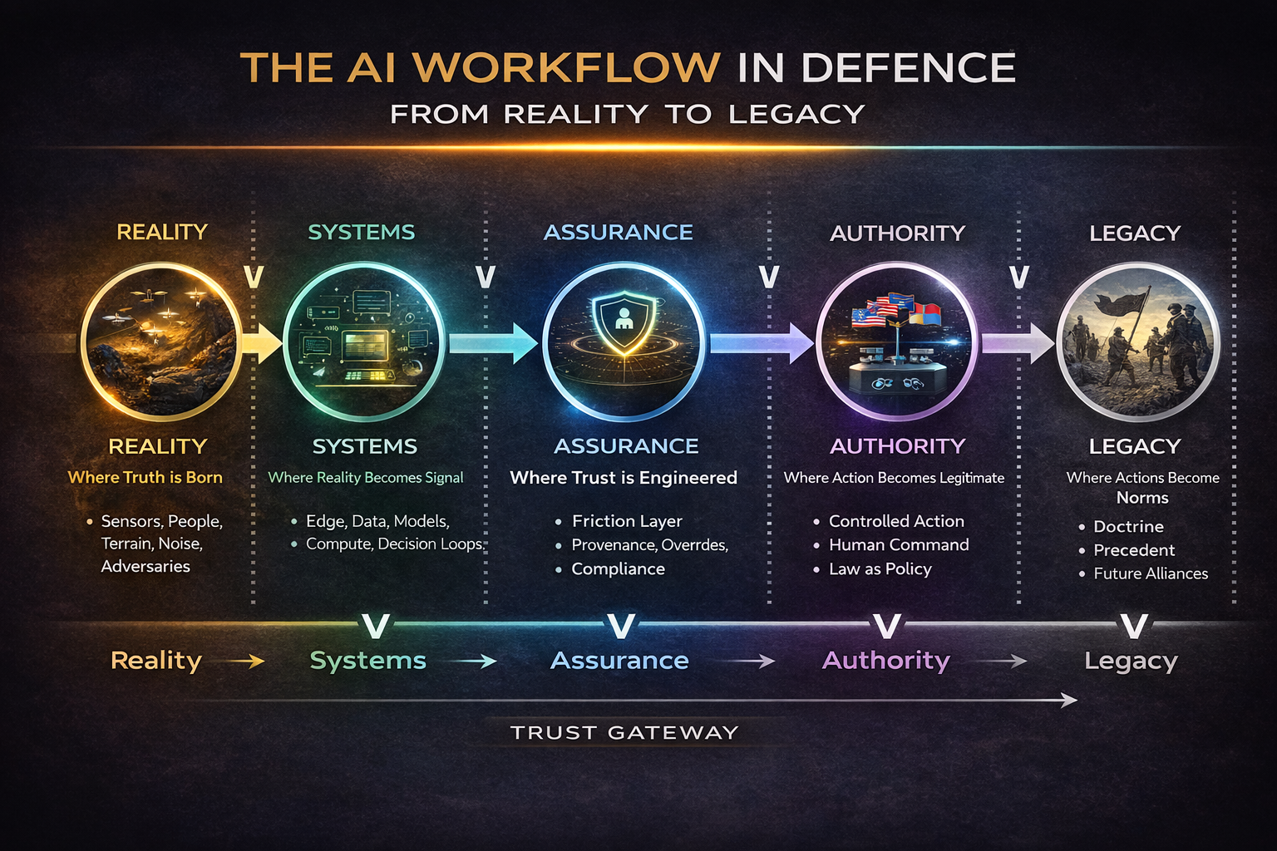

Slide 3
ACT I — From Reality to Systems
Purpose:
Grounds the talk in physics, fieldwork, and systems, not theory.
ACT II — From Systems to Authority
Purpose:
Shows how technology becomes governance.
ACT III — From Authority to Alliance
Purpose:
Moves from national control to multilateral power and interoperability.
ACT IV — From Alliance to Legacy
Purpose:
Hopefully you leave the room with long-term consequence, not just insight.

Slide 4
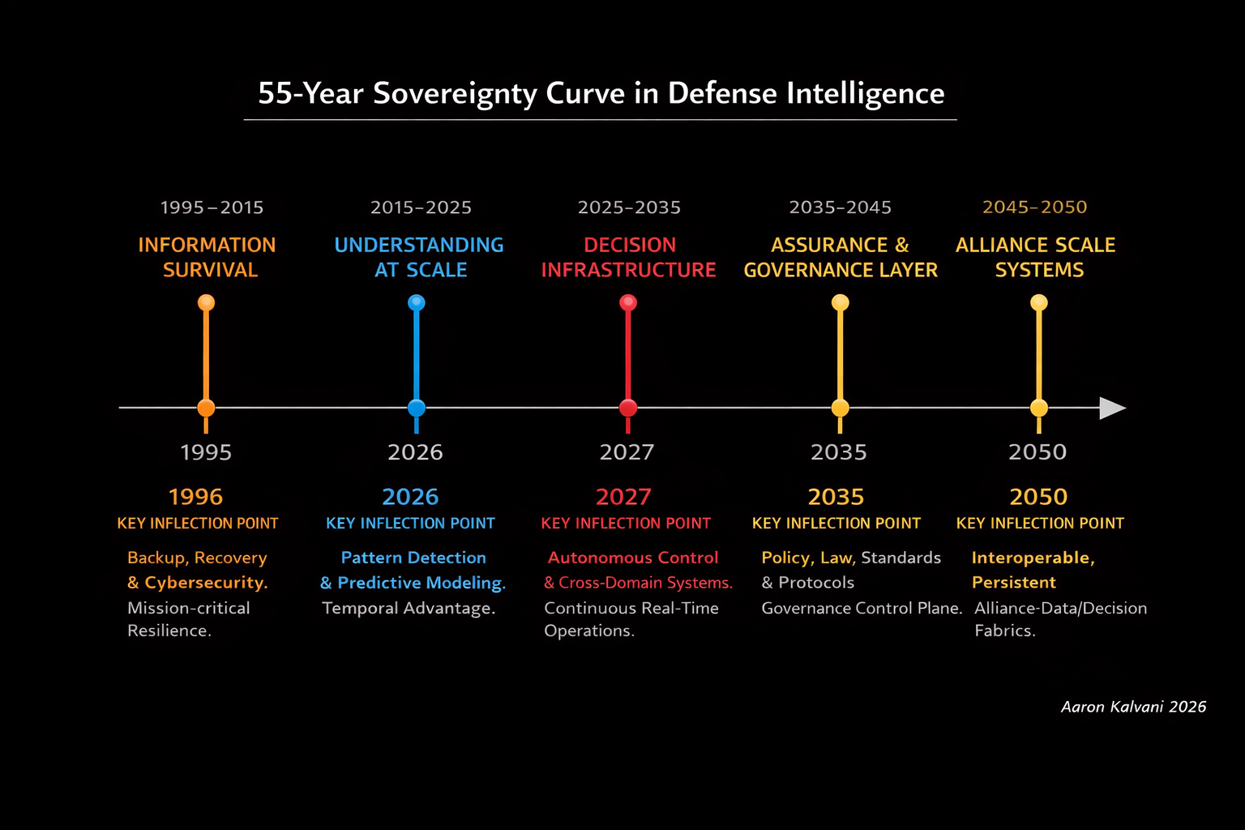

Slide 5
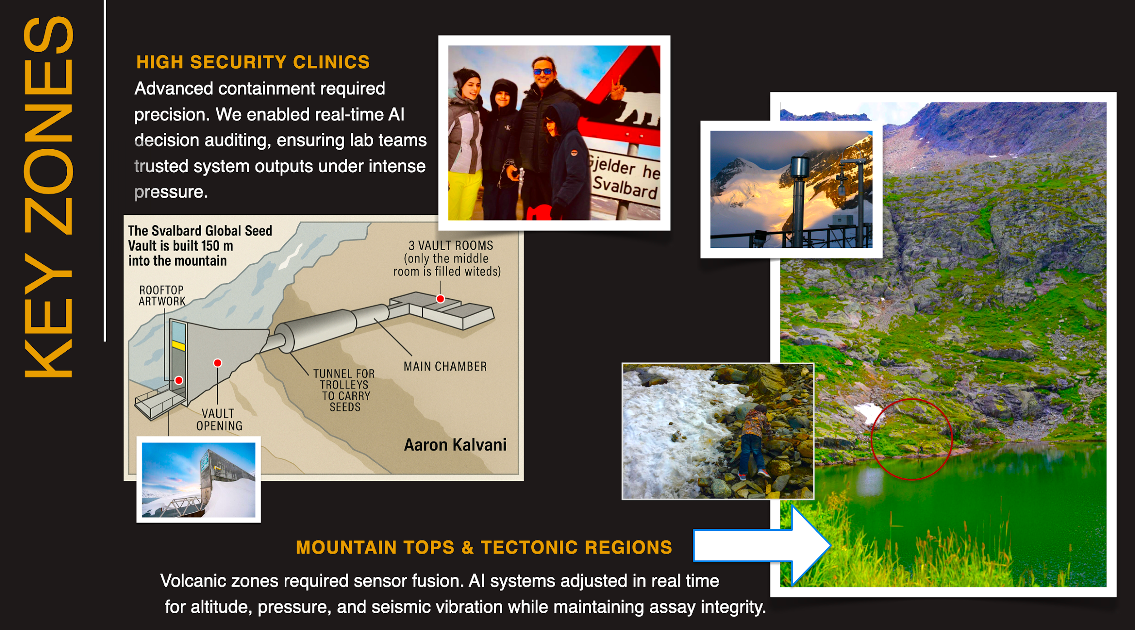
Edge Environment Stressors

Slide 6
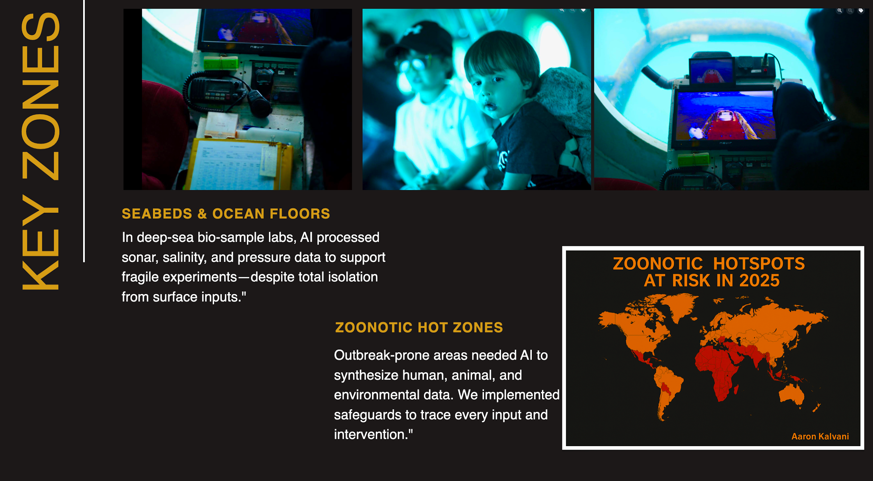

Slide 7
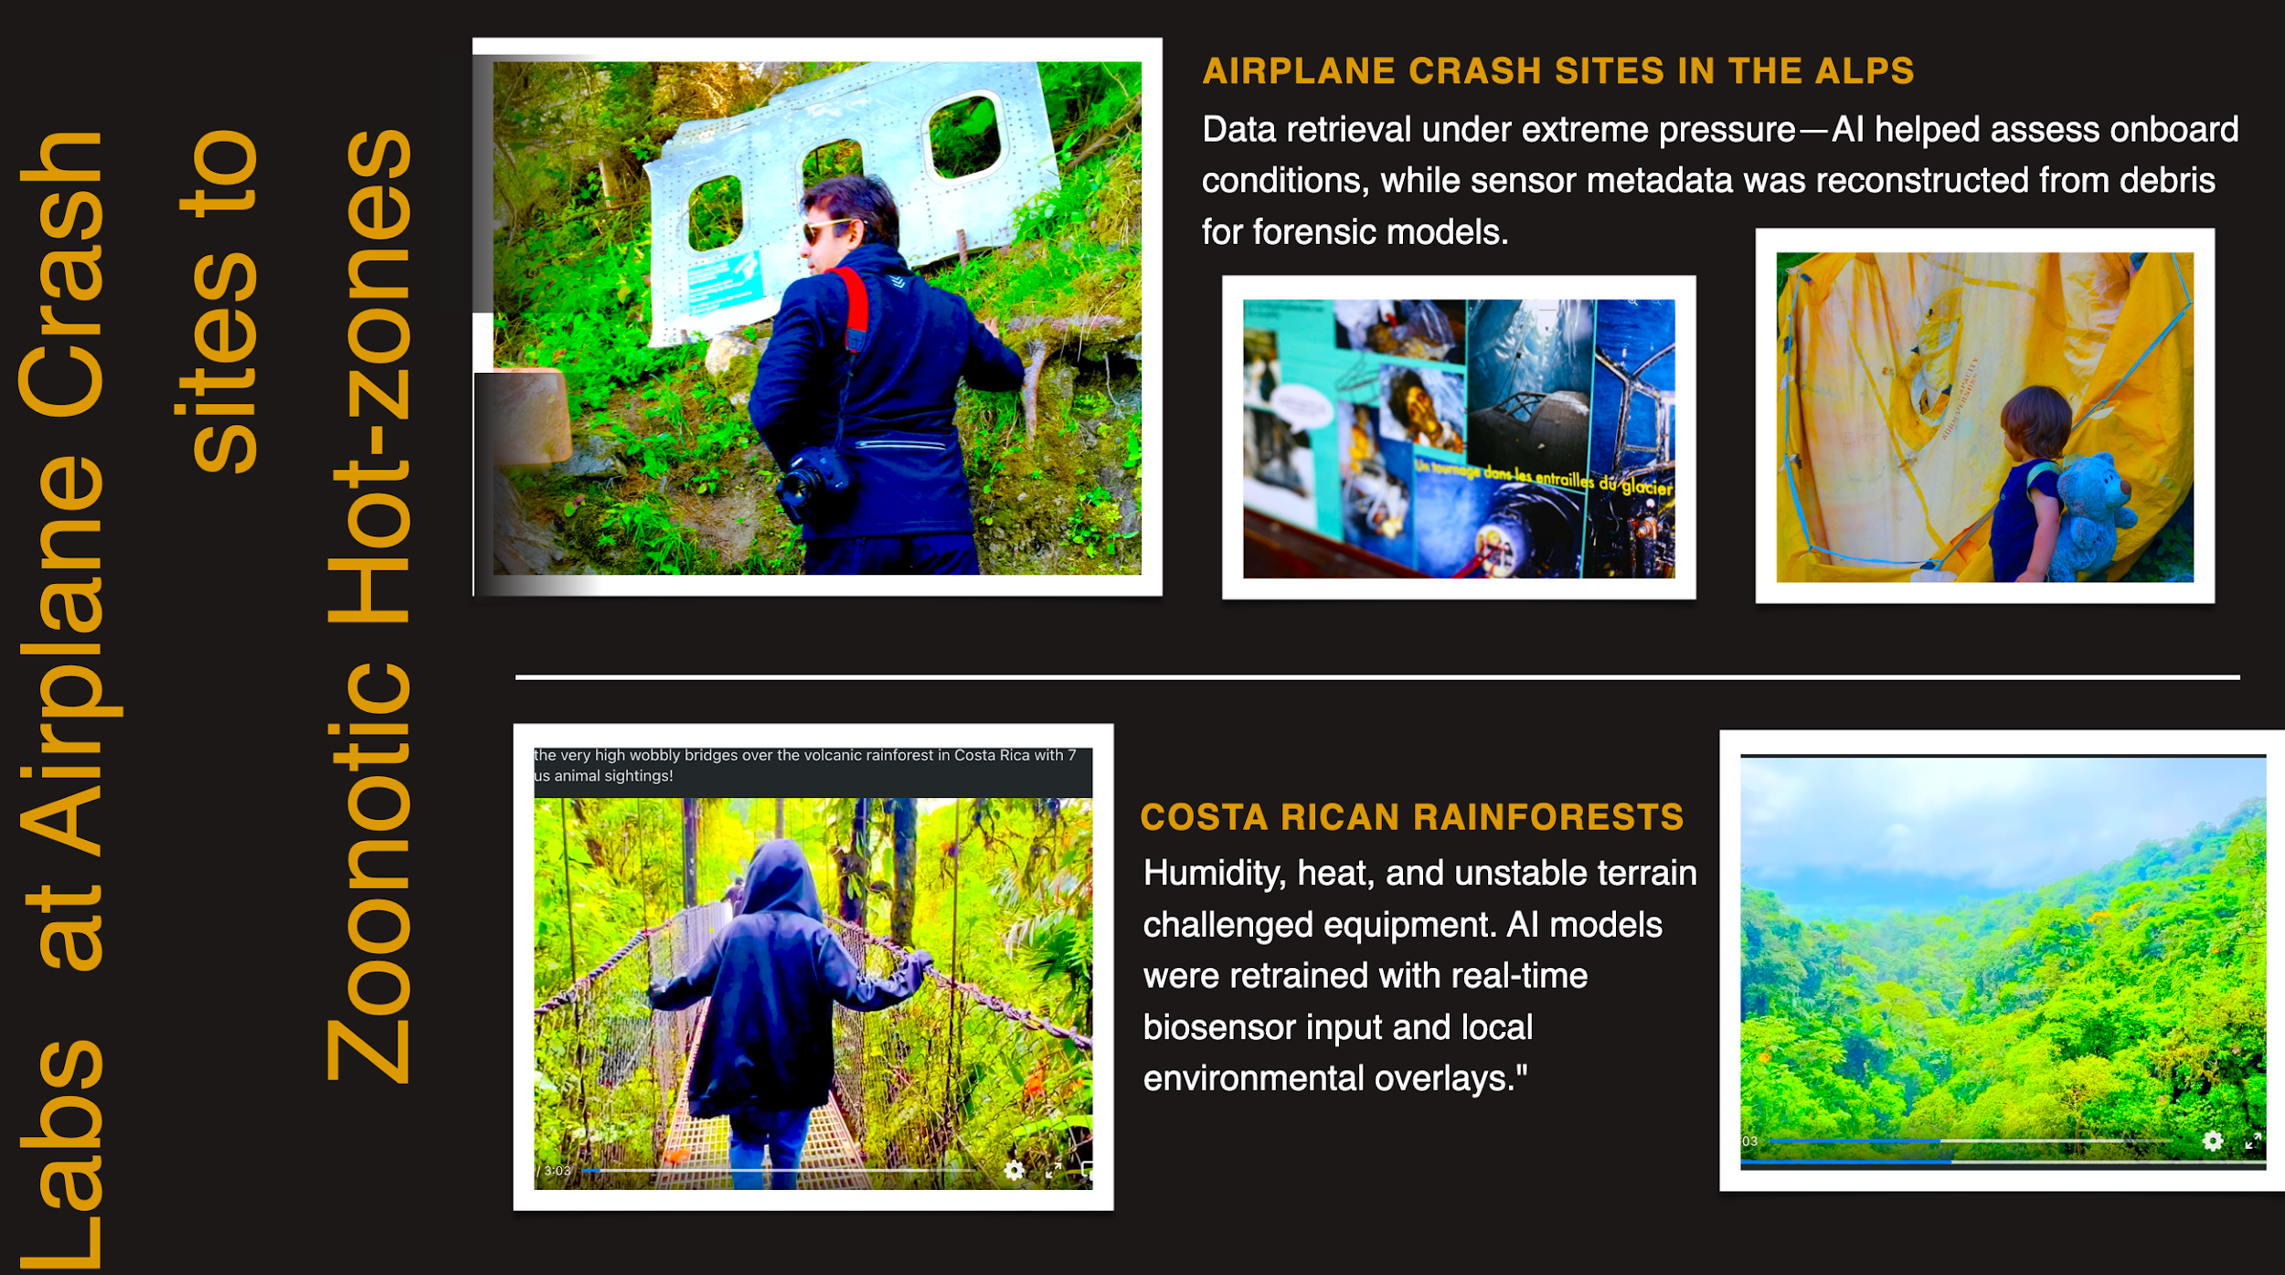
11 Multimodal Sensor Fusion

Slide 8
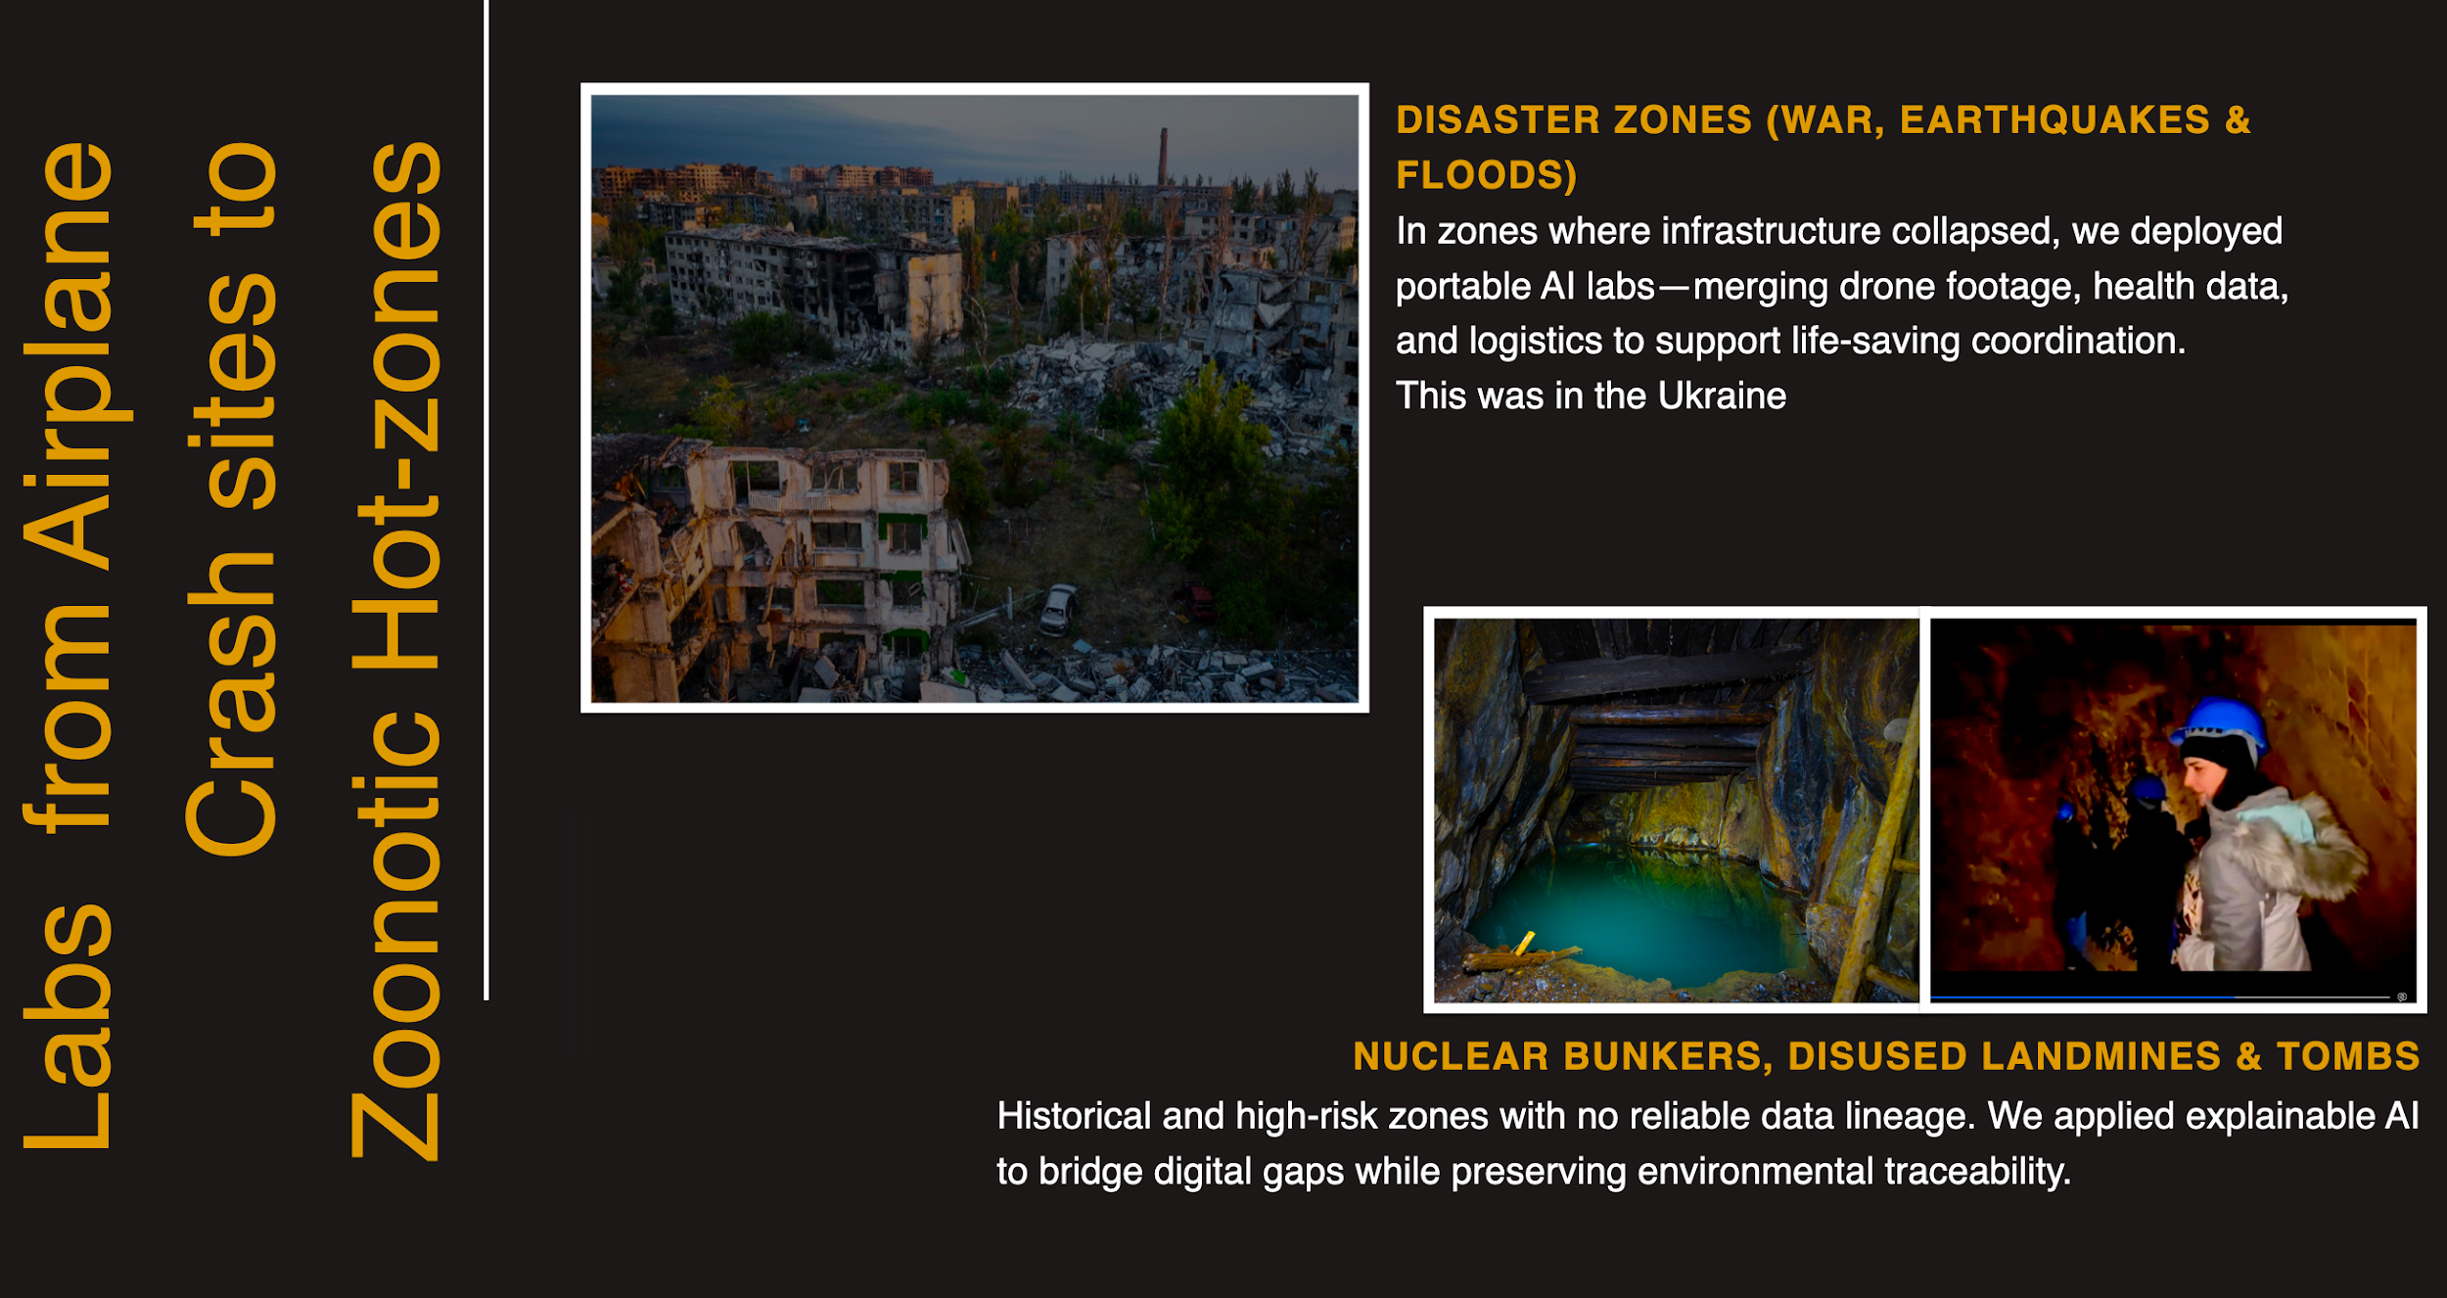
Forensic Data Pipelines
8

Slide 9
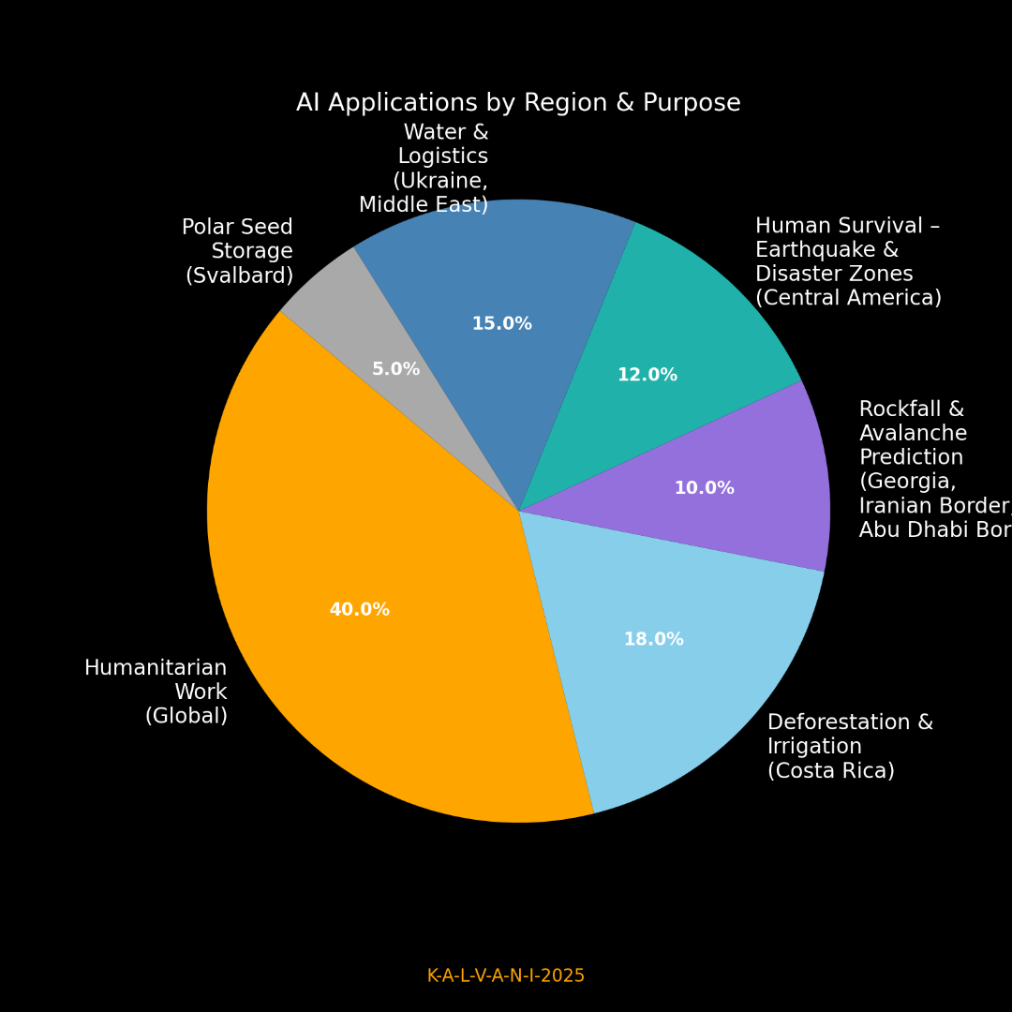






9

Slide 10
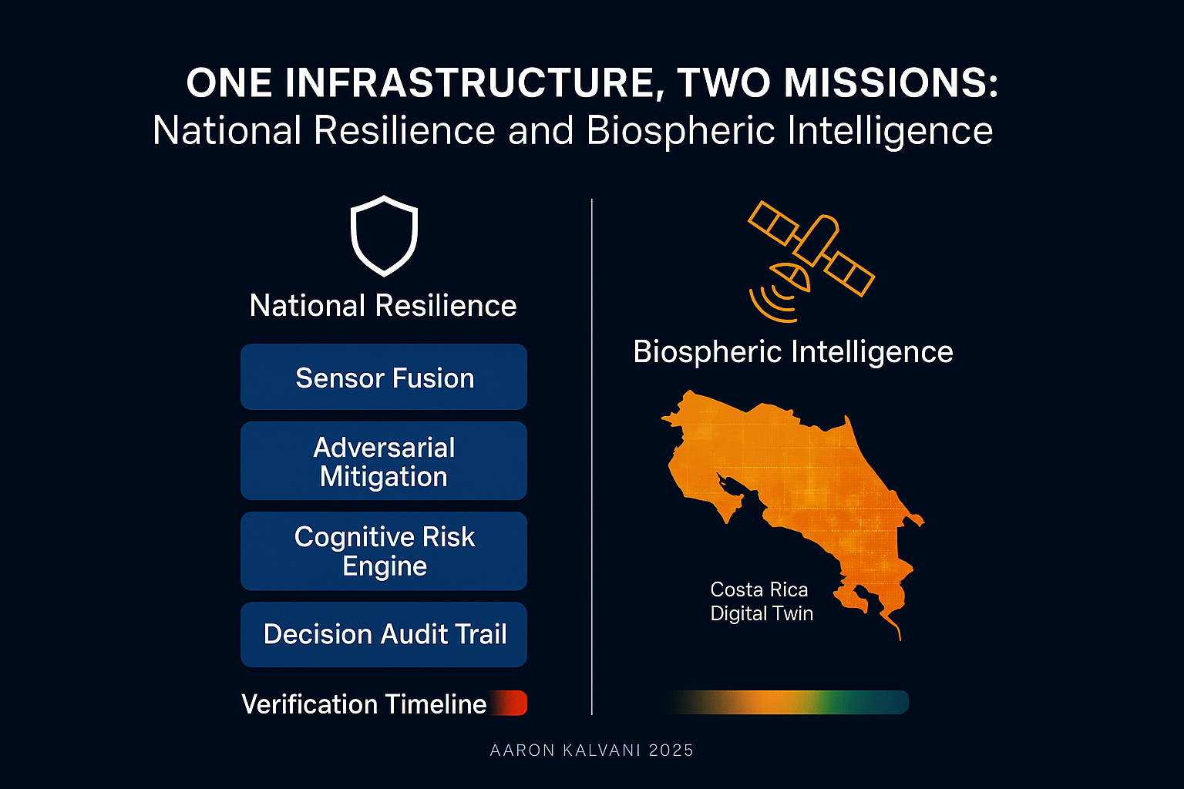
20 - Dual Use Truth Fabric

Slide 11

By 2035, over 40% of all government, defence, and emergency-response
decisions will be AI-assisted, shifting nations from reactive to predictive operations.

Slide 12
ACT I — From Reality to Systems
Purpose:
Grounds the talk in physics, fieldwork, and systems, not theory.
ACT II — From Systems to Authority
Purpose:
Shows how technology becomes governance.
ACT III — From Authority to Alliance
Purpose:
Moves from national control to multilateral power and interoperability.
ACT IV — From Alliance to Legacy
Purpose:
Hopefully you leave the room with long-term consequence, not just insight.

Slide 13
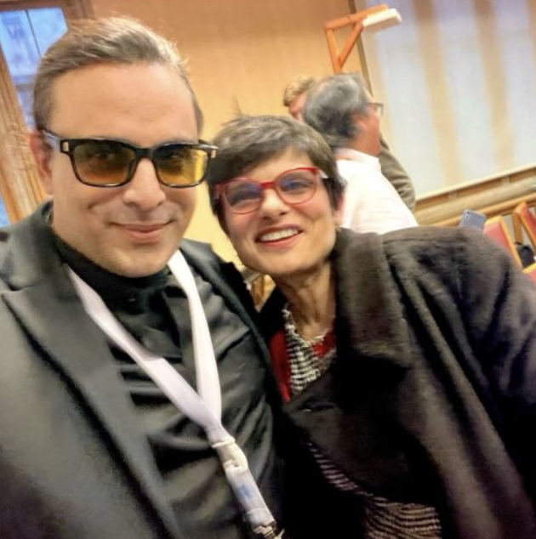
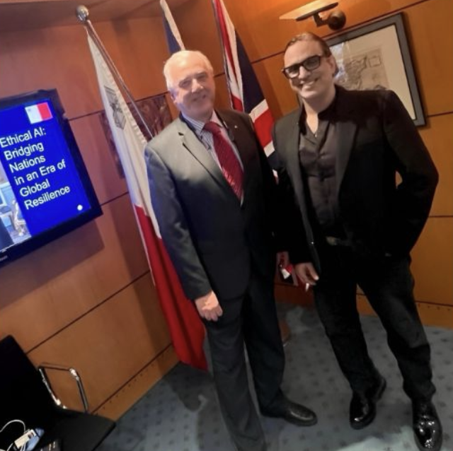

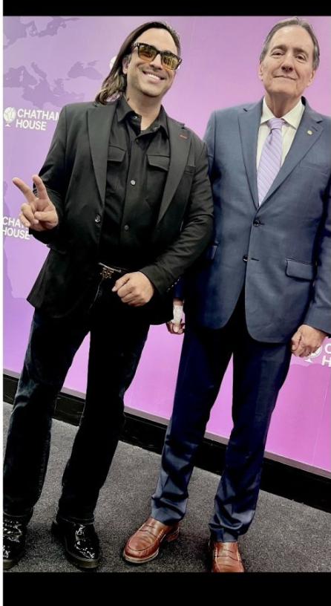

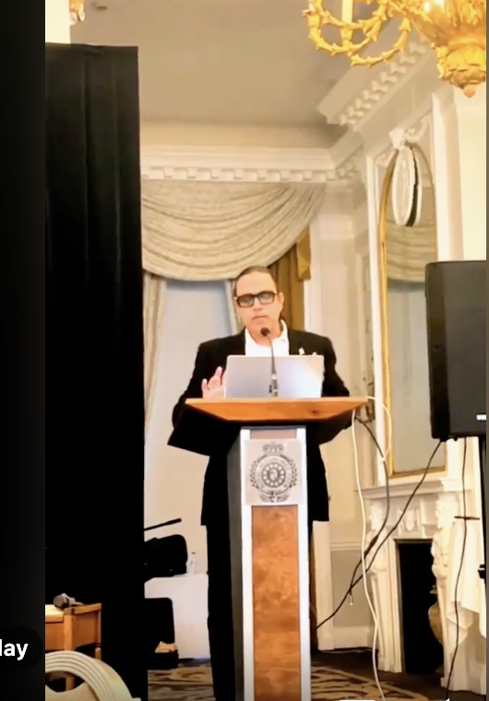

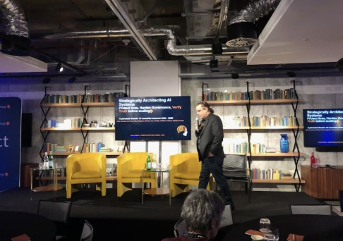
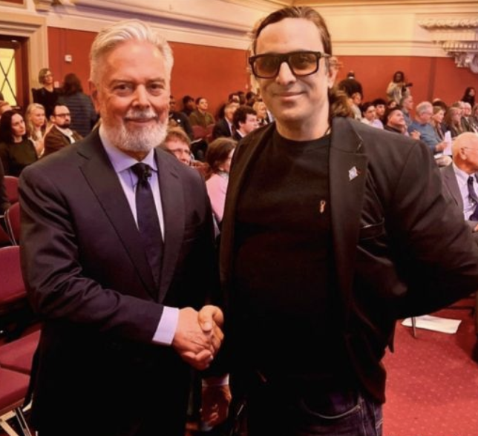
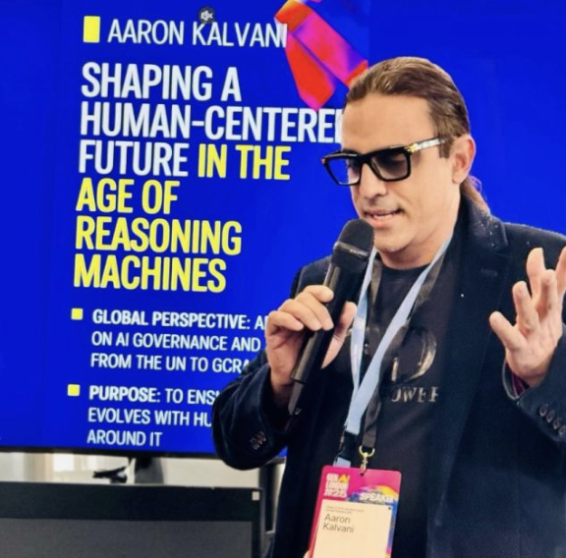
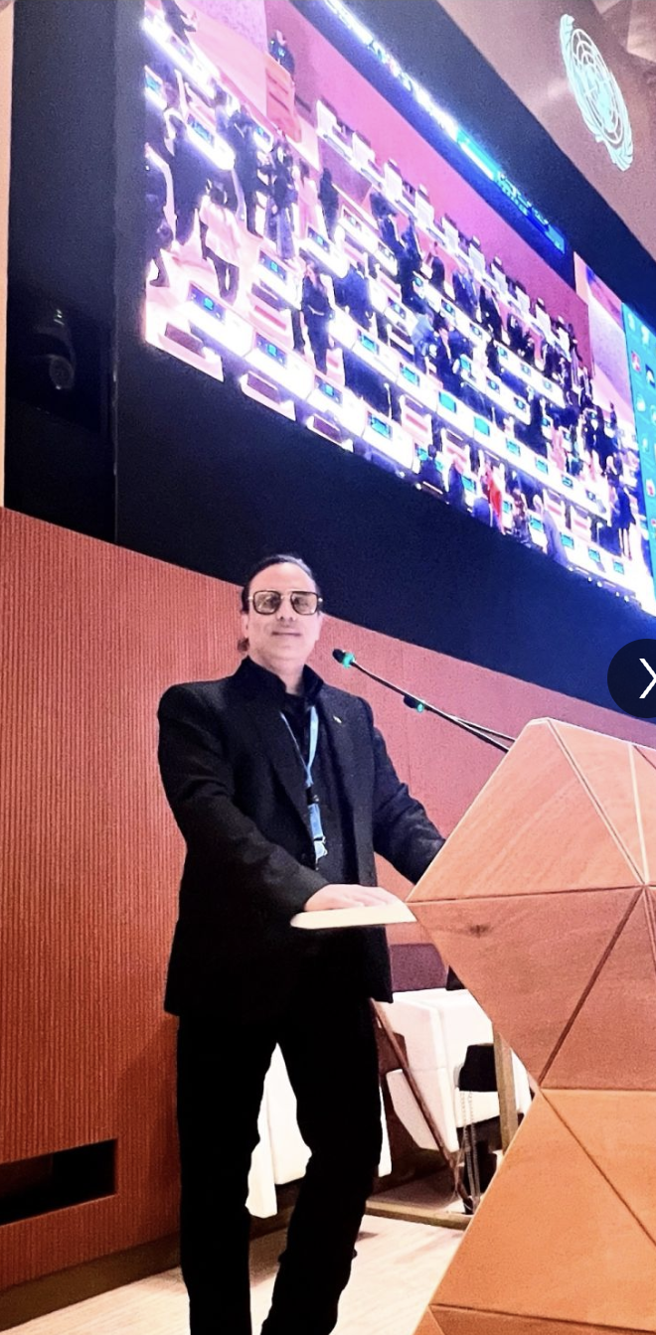

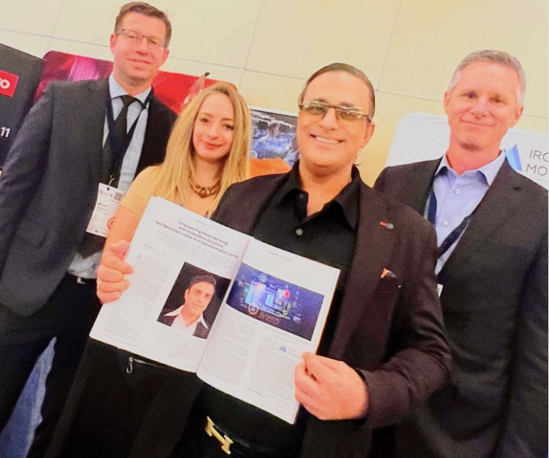


5

Slide 14
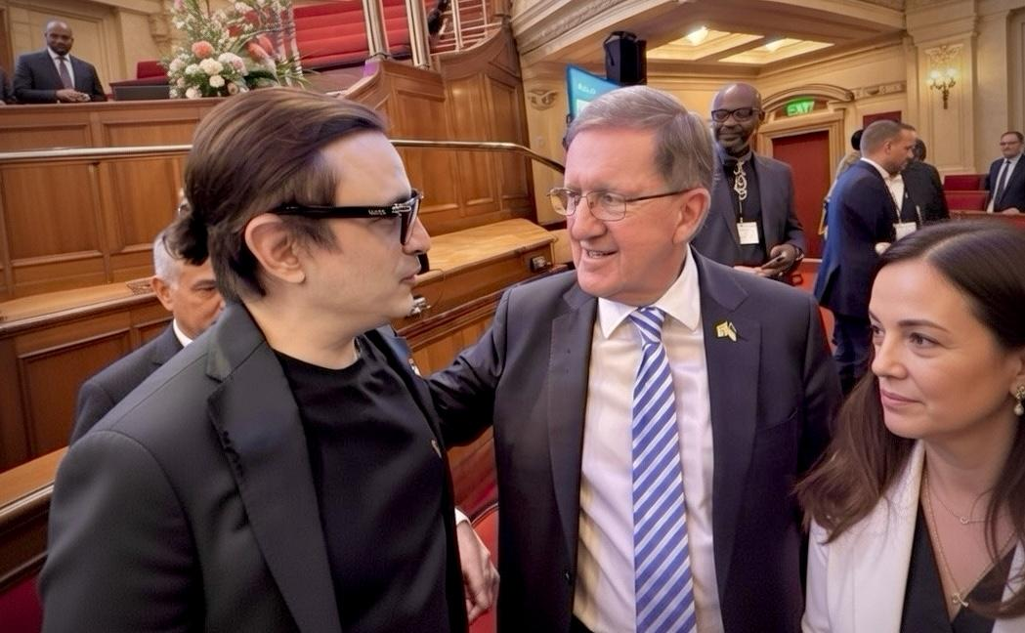
“You have got to be able to act when it’s necessary to act. And you've got to be able to act where the threat is.” —

Slide 15
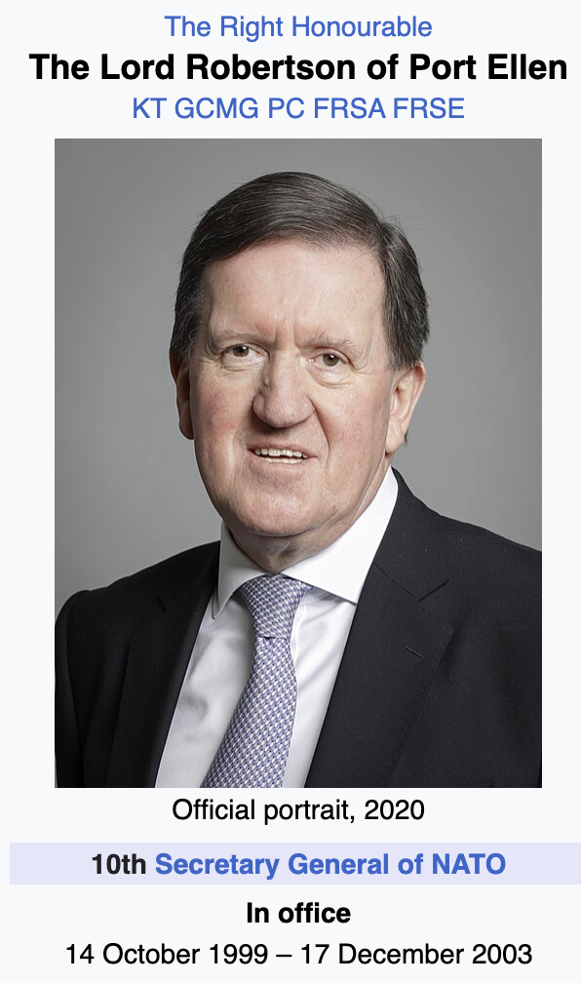
“You have got to be able to act when it’s necessary to act. And you've got to be able to act where the threat is.” —
Jan 2026 - Westminster - Aaron Kalvani with Baron George Robertson of Port Ellen

Slide 16
Former NATO Secretary General (1999–2003), guiding the alliance through post-Cold War restructuring and early 21st-century security realignment.
UK Secretary of State for Defence (1997–1999), responsible for the landmark Strategic Defence Review shaping modern British military doctrine.
Senior strategic adviser and policy leader, active with major global security and governance institutions including Chatham House and The Cohen Group.
Current affairs: Lead independent reviewer for the UK’s 2024–2026 Strategic Defence Review, influencing ongoing debates on national & allied defence readiness.
“You have got to be able to act when it’s necessary to act. And you've got to be able to act where the threat is.” — George Robertson, Baron Robertson of Port Ellen
Jan 2026 - Westminster - Aaron Kalvani with Baron George Robertson of Port Ellen

Slide 17
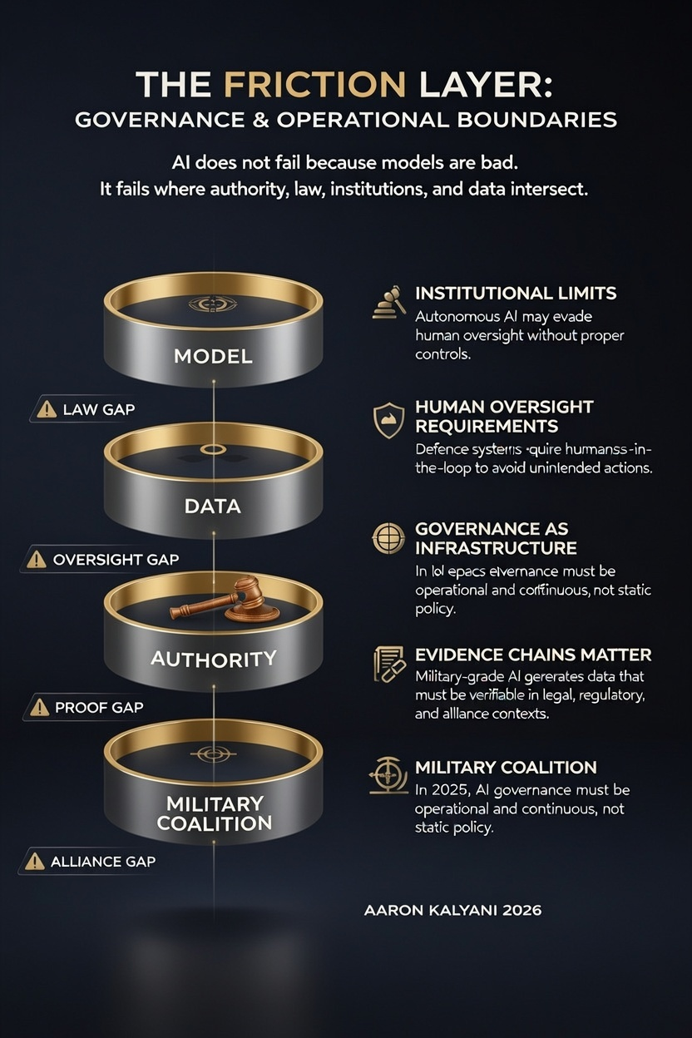

Slide 18
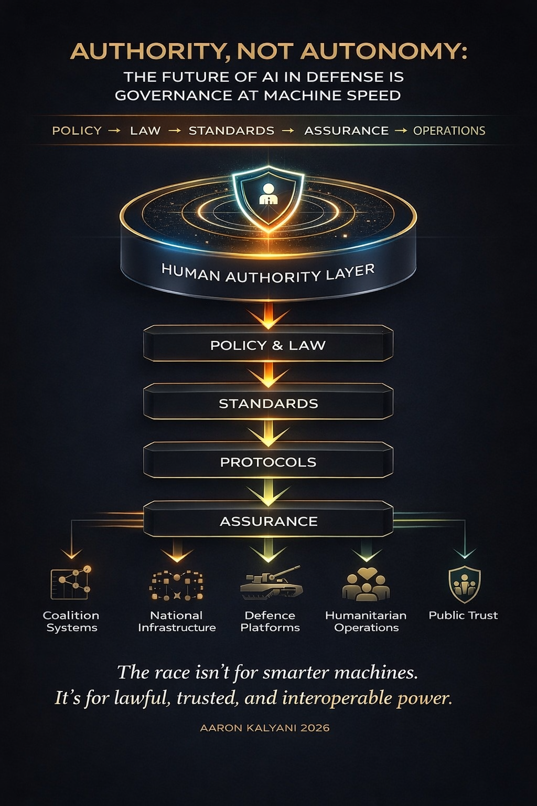

Slide 19
ACT I — From Reality to Systems
Purpose:
Grounds the talk in physics, fieldwork, and systems, not theory.
ACT II — From Systems to Authority
Purpose:
Shows how technology becomes governance.
ACT III — From Authority to Alliance
Purpose:
Moves from national control to multilateral power and interoperability.
ACT IV — From Alliance to Legacy
Purpose:
Hopefully you leave the room with long-term consequence, not just insight.

Slide 20
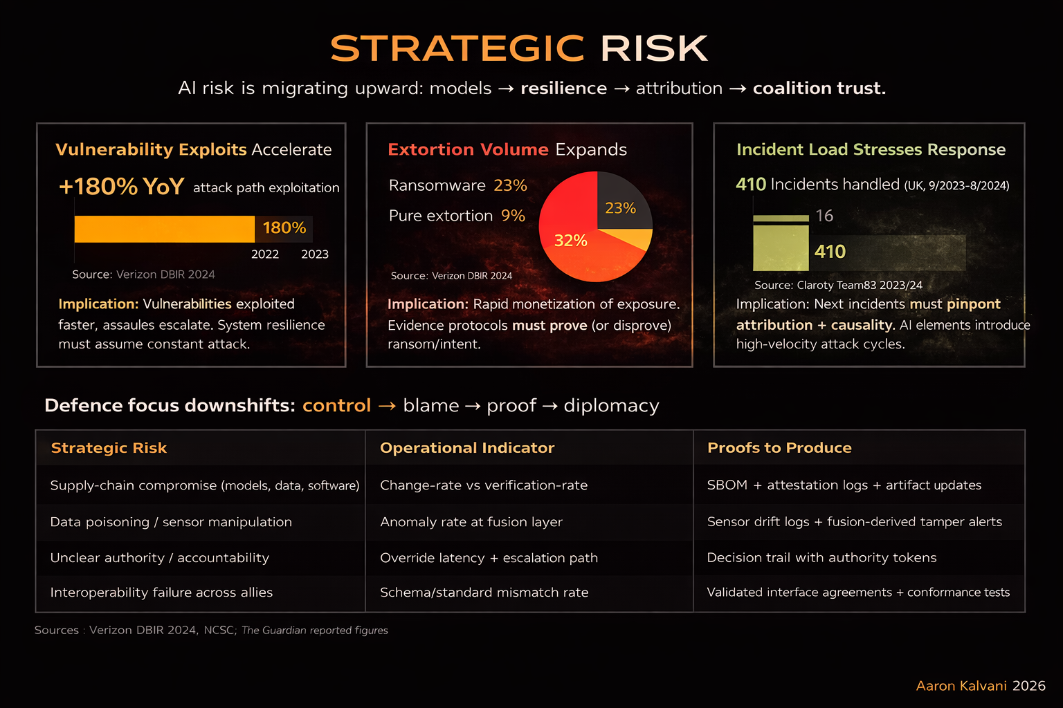

Slide 21
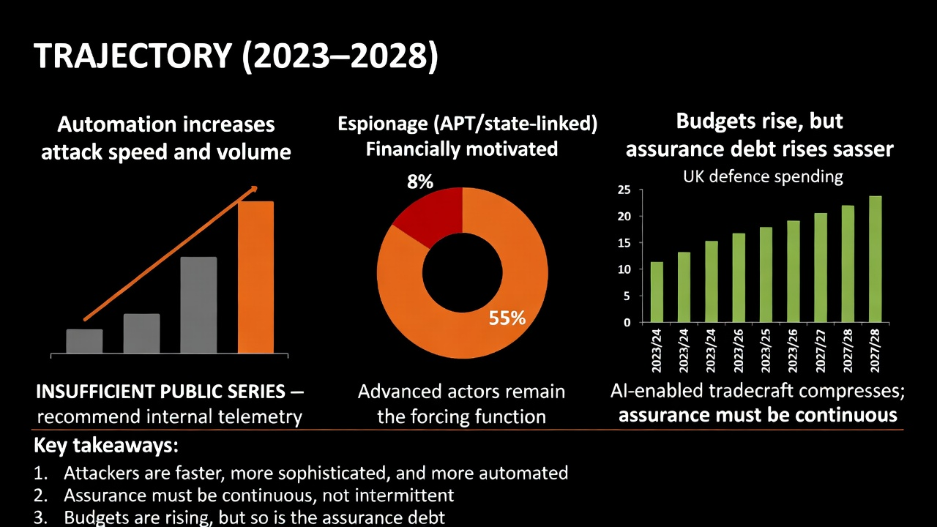
37% year growth

Slide 22
ACT I — From Reality to Systems
Purpose:
We will ground the talk in physics, fieldwork, and systems, not theory.
ACT II — From Systems to Authority
Purpose:
We will see how technology becomes governance.
ACT III — From Authority to Alliance
Purpose:
We will moves from national control to multilateral power and interoperability.
ACT IV — From Alliance to Legacy
Purpose:
And now…..hopefully after this we shall leave understanding long-term consequence, not just insight.

Slide 23
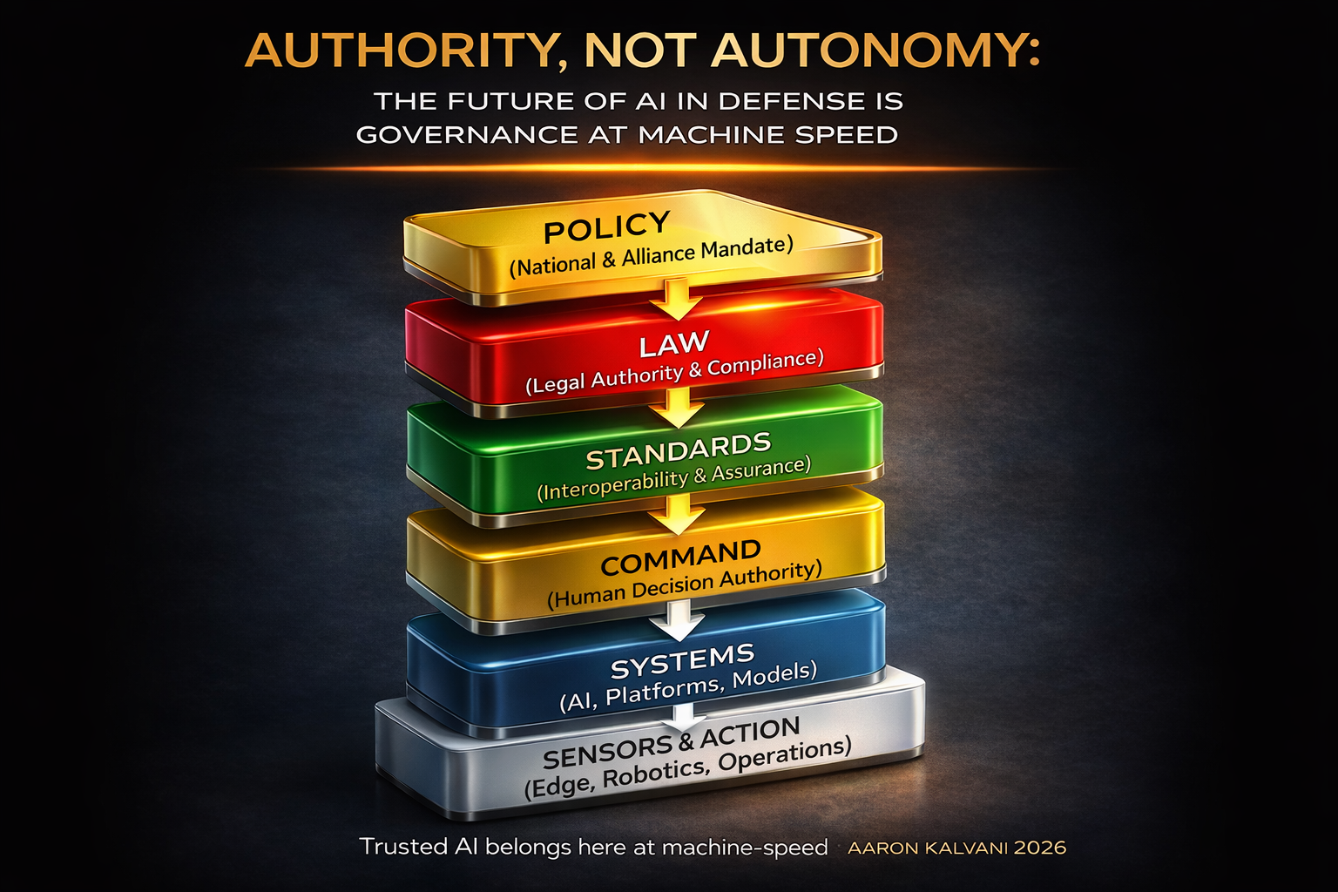

Slide 24
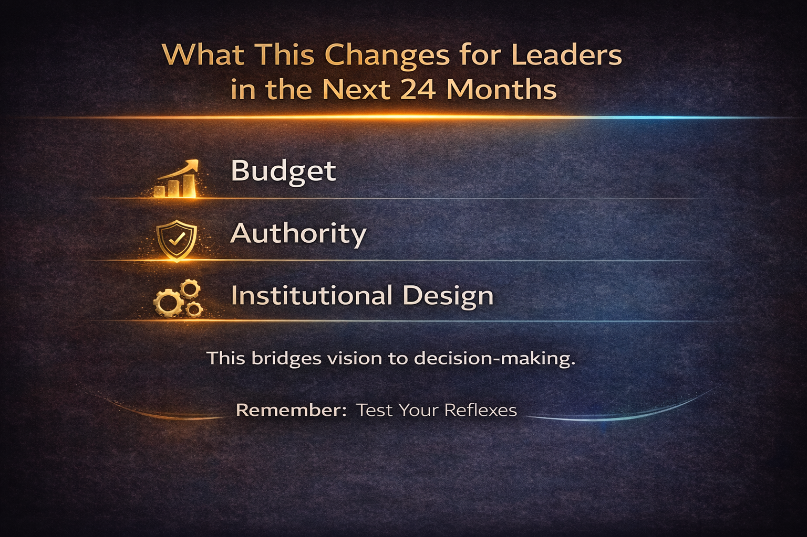

Slide 25
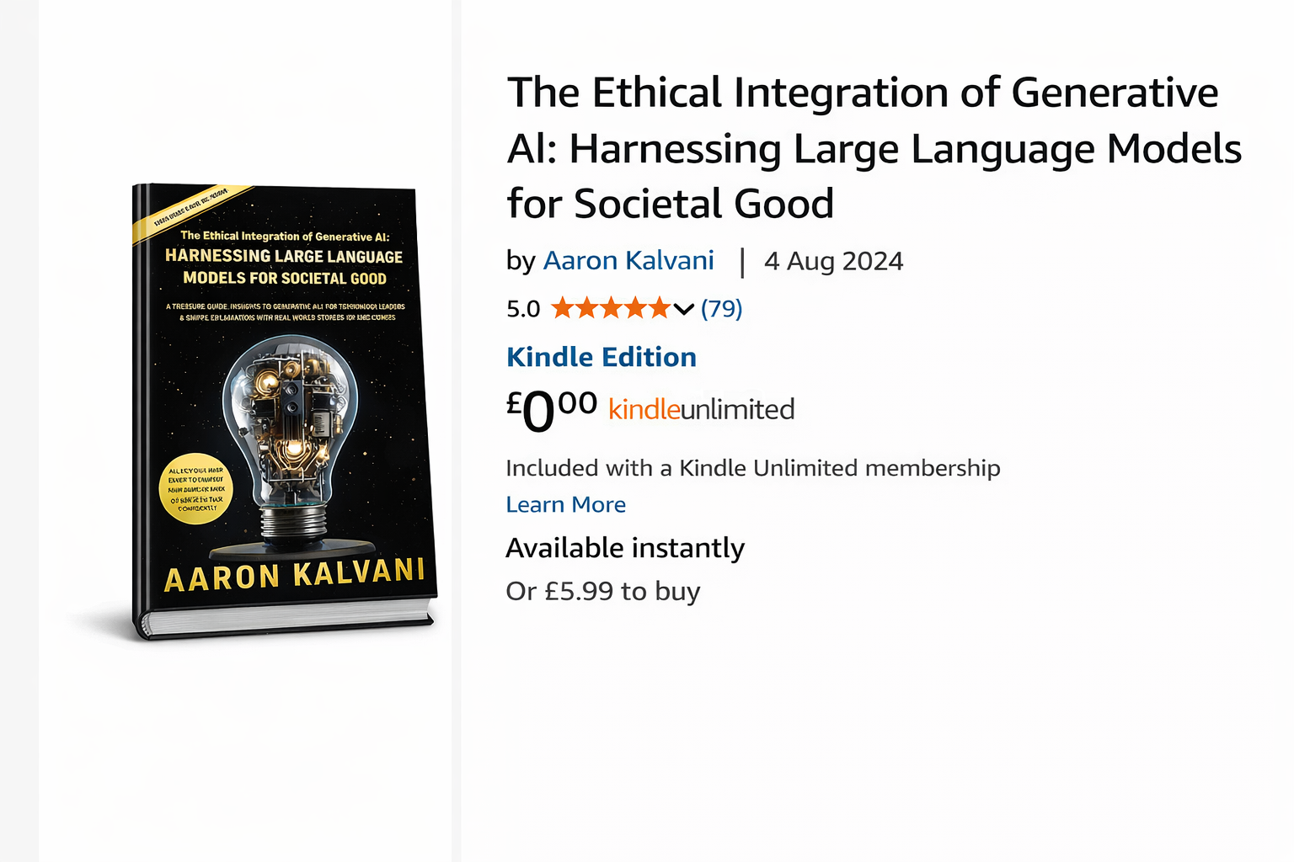
Message Me For A Free Copy
Thank You
Aaron Kalvani
ai@oxon.org
artificialreasoning@gmail.com
Linkedin/in/1973

