Slide 1



Brigadier Stu Nassé OBE (GBR)
Hd Drone Capability Coalition

Slide 2

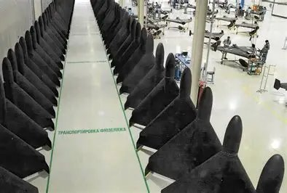

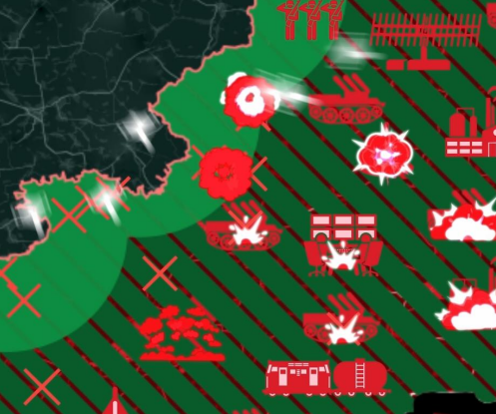
Ongoing Projects – cohering support
These projects provide ongoing vehicles for international support throughout 2026
Continuous Feedback
End state
Known MOTS
Emergent MOTS
LOE 1
Buy UKR
Overmatch 500 Shahed Per Day
Known MOTS
Emergent MOTS
LOE 2
Buy UDCG
Competitions / R&D / Next Development
Fail
LOE 3
Test
Emergent
Alternative Effects
Pass
LOE 4
Air
Land
EW
IT
ALT EFFECTS
Known MOTS
Emergent MOTS
LOE 1
Buy UKR
Established engagement depth of 20-100km
Known MOTS
Emergent MOTS
LOE 2
Buy UDCG
Competitions / R&D / Next Development
Fail
LOE 3
Test
Emergent
Alternative Effects
Pass
LOE 4
Air
Artillery
EW
IT

Slide 3
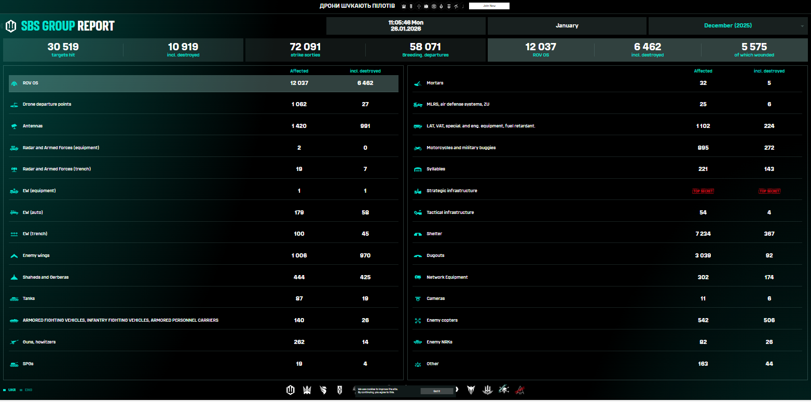
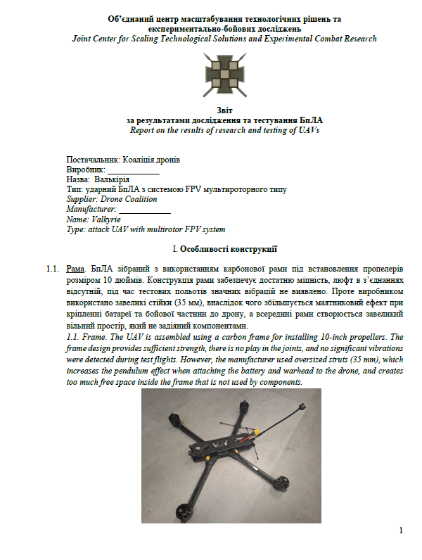
Data led decision making
Continuous feedback loop
T&E

Slide 4
