Slide 1
Strengthening Cyber and IT Resilience across the Bundeswehr
DIRECTORATE-GENERAL INNOVATION AND CYBER
CDAO Defence UK
Captain (Navy) Daniel Prenzel,
Directorate-General for Innovation and Cyber
Policy, Planning and Procurement, Cyber and Information Systems Branch
27 January 2026

Slide 2




Cyber and Information Domain
Cyber and Information Domain
Cyberspace
Electromagnetic Spectrum
Information Environment

Slide 3


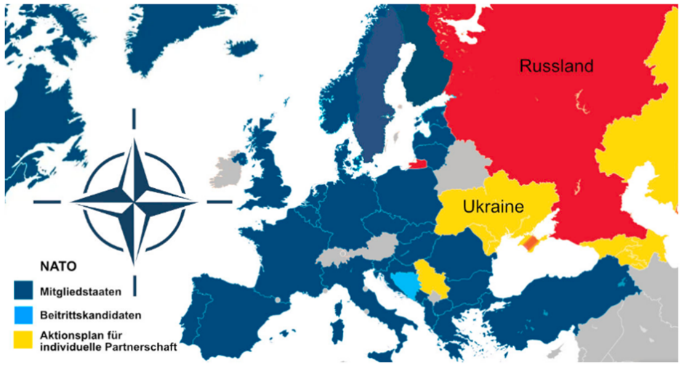
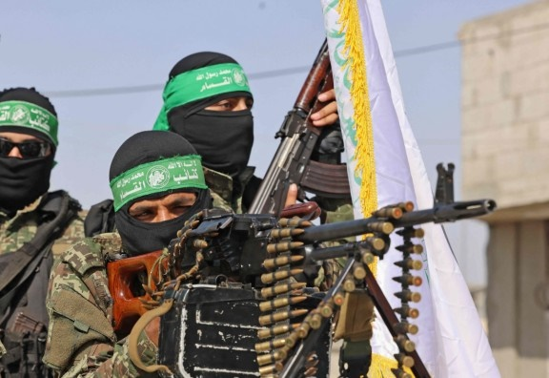

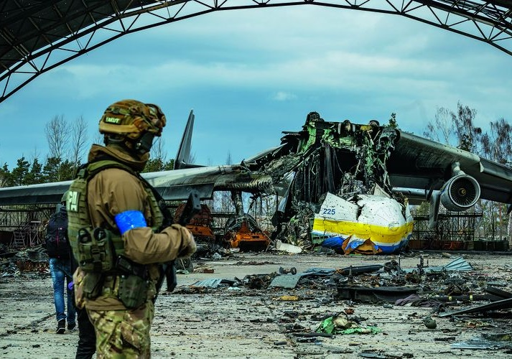
Challenges (in the Cyber and Information Domain)
Grey Zone

Slide 4


Directorate-General Innovation and Cyber in the Federal Ministry of Defence
Executive Staff
Minister of Defence
Boris Pistorius
Press and Communications Office / FMoD Spokesperson
Parliamentary State Secretary
Hartmann
State Secretary Plötner
Chief of Service Council
Chief of Defence
General Breuer
State Secretary Hilmer
State Secretary Dr.Stöß
Parliamentary State Secretary
Dr. Schmid
Office
Office
Vice
ChoD
Vice
ChoD*
Office
Office
Office
Office/Adj.
Overall Military Defence Concepts and Planning
FMoD Situation and
Command Centre
DG Armament
(Rü)
DG
Innovation and Cyber (IC)
DG Armed Forces
(SK)
DG
Policy
(Pol)
DG Augmentation
(A)
DG Budget
(H)
DG Legal Affairs
(R)
DG Central Affairs
(Z)
Strategic Management and Planning
Research, Innovation, AI
Capabilities Cyber/IT

Slide 5








Tasks of the CIDS
Intelligence
IT Services
Armed Forces Security
Reconaissance, Effects,
Operation and Protection
as
J2 Bundeswehr
as
J6 Bundeswehr
as CSOBw
including CISOBw
in the CID
Geospatial Support
Space
Cyber Defense
Digitalization
as Enabler
Operation and
Mission Support
As part of a holistic national approach
Driving Force behind the
Digital Transformation

Slide 6

Whole-of-Government Approach
Cyber-Defence
FMoD
National Security Council
National Cyber Security Council
ZCSBw
KdoCIR
BIT-S
ZGeoBw
ZOpKom
MAD
ZCO
Cyber-Response
National Cyber Response Centre
Cyber-Foreign Policy
BSI
MoI
MoFA
BfV
Cyber Norms
state / non-state actors
Internal / external security,
peace, crisis, war
CERT Bund
International Humanitarian Law
BKA
Confidence-Building Measures
KRITIS
Active defense against cyber threats from abroad
BMDS
…
Federal IT-Security

Slide 7
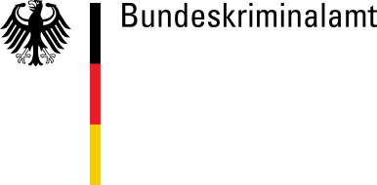
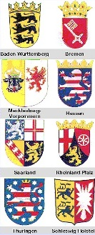



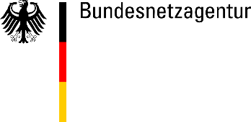


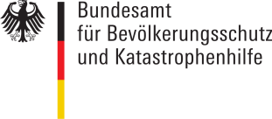

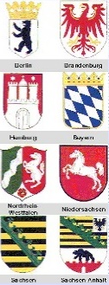






Contribution CIDS to intergovernmental
Cyber Security
National Cyber Response Centre
Military Counter-Intelligence Service
Federal Criminal Police Office
Federal Office for
IT-Security
Federal Intelligence Service
Customs
Federal Network Agency
Federal Office for
Civil Protection &
Disaster Relief
CIDS HQ
Federal Office for the Protection of the Constitution
Federal Police
Ministry of Defence
Ministry
of
Internal Affairs
Office of the Federal Chancellor
Ministry
of
Finance
Ministry
of
Economics
Federal States
ISP,
Economy
& IT
Security
Companies
Main Authorities
Supporting Elements

Slide 8

Digital Sovereignty
Digital Sovereignty
The Federal Ministry of Defense understands the term “digital sovereignty” to mean the existence of the necessary control and action capabilities in cyberspace and the information domain to enable the Bundeswehr to carry out its constitutional mandate securely, independently, and free from unwanted influence by third parties.
Use of trustworthy IT
Develop and preserve key technologies
Maintain Core-C2-Capabilities
Promote innovation capability
Build and preserve digital skills
Ensure data sovereignty
Information security
Certification for hardware and software
Trustworthy operating environment
Increased use of contractual possibilities
Specification of key technologies
Reduction of dependencies
Structuring of the Core-C2-Capabilities
Capacity to act in the event of defense
Promotion of national developments
Rebuilding a culture of innovation in Germany
Training and continuing education for users, consumers, and developers
Raising awareness of digital sovereignty
Ensuring confidentiality, integrity, and availability for all data content within the national legal framework
e.g., in the case of intended provision via the armed forces' own facilities
e.g., promotion of (national) champions
e.g., strengthening redundancy and resilience of our IT
e.g., Cyber Innovation Hub, Cyber Agency
e.g., masterclasses, practical application in everyday life
e.g., encryption only under military authority, hosting in private cloud

Slide 9
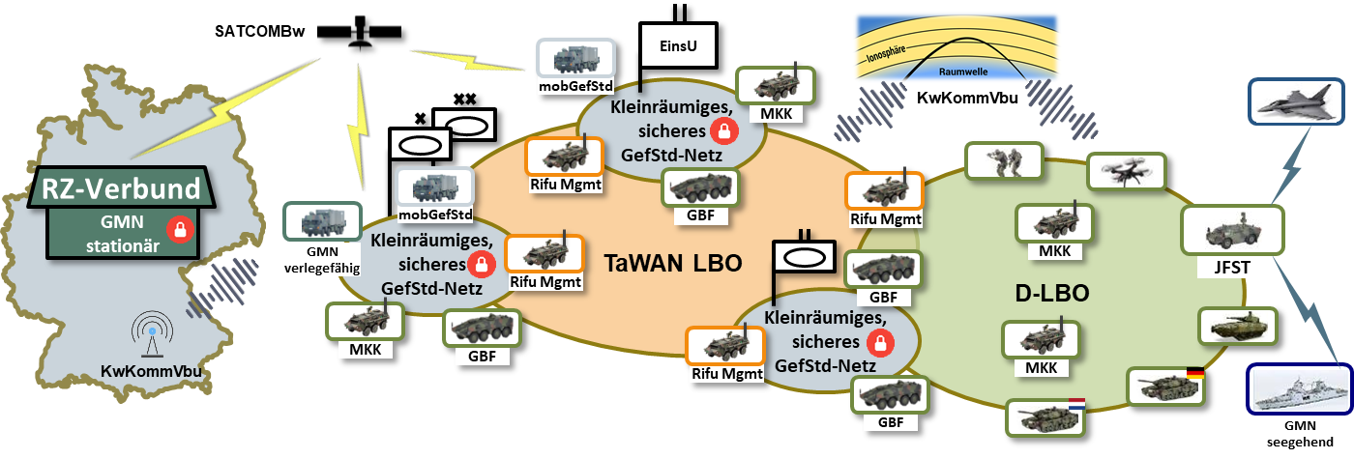
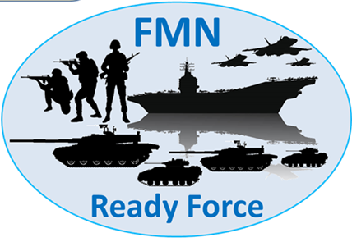
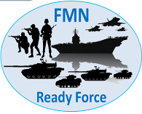


Bundeswehr Command and Control (C2) Capabilities
IT service delivery
IT services for
foreign and domestic departments
IT services for
long range connectivity and networking
IT services for
stationary and deployable facilities
IT services for
mobile elements
chain of command
Prerequisite for
Multi Domain Integration
Information -,
command & control - and
effects superiority
Digitization of a coherent and interoperable information-/communication network
DEU – AOR – AOO

Slide 10

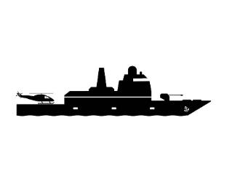











Software Defined Defence – Target Architecture
Innovation cycles
approx. 10 years
approx. 2 years
SDDBw Foundation
Situation picture
Chat
Voice
weeks
???

Slide 11
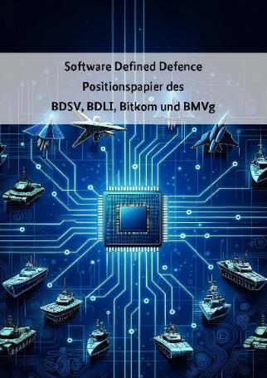



Software Defined Defence
The paradigm for armed forces fit for the future
SDD describes the enormous potentials of software for the continuous improvement and/or extension of weapon system capabilities and the subsequent increase of the Bundeswehr’s performance capability.
SDD creates an added value by:
Cross-platform networking and integration of the platform-specific capabilities required for this purpose
Faster adaptation of software to new short-term operational requirements
Capability augmentations and increase in the performance of existing systems by software
Software-Defined Defence
Position paper of BDSV, BDLT, Bitkom, and FMOD
Among others, the following aspects are important in the implementation:
Establishment of an open modular system with defined interfaces in terms of a digitisation ecosystem
Acceleration of (software) development and provision processes throughout the Bw and industry
Change of thinking in planning and armament processes by public purchaser and industry (incl. award procedures)

Slide 12

Data – A Strategic Asset
MDO
Digital battlefield
SDD
DATA
Analytics & Simulation
AI/ML

Slide 13




Data – A Strategic Asset
We are building up a data-oriented organization.
CDO
Quality of data
Data Strategy
Continuous improvement of our data bases.
Making Data ready for Analytics and innovations.
Using Data as an asset. Giving guidelines to our organization.
Data-driven organization
signed by FMoD!
Data Governance
Data-modelling
Leading with Data as an strategic asset.
Visualize our data streams and dependencies between applications.
Enterprise Architecture
Enterprise Architecture will be the first step in establishing data management.
We will use NATO Architecture Framework Version 5.

Slide 14
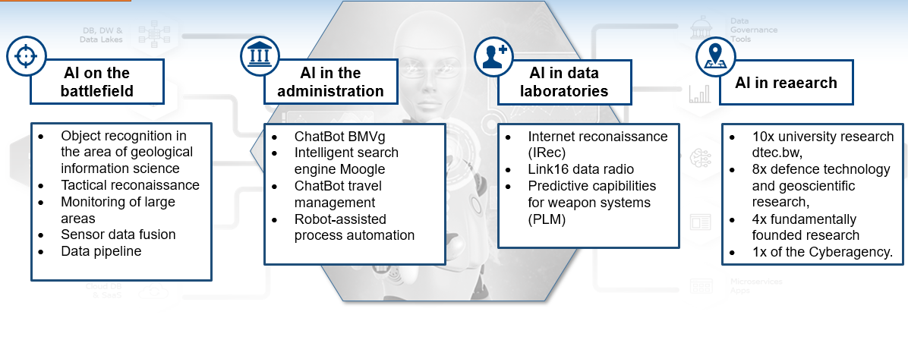
Artificial Intelligence and Data
Current AI activities
Establishing the conceptual framework for responsible use of AI
Developing AI applications in different areas
Updating…

Slide 15




Research and innovation landscape related to Cyber/IT
Utilizing the potential of the start-up ecosystem for innovation projects in the Federal Armed Forces
Promoting a culture of innovation by empowering employees to become intrapreneurs
Targeted commissioning of projects with high innovation potential in the area of cyber security, orientated towards the needs of internal and external security
Cyber Innovation Hub Bw
(CIHBw)
Cyber
Agency
Research institute
CODE
(RI CODE)
Digitalization and Technology Research Center of the Bundeswehr
(dtec.bw)
Study and research opportunities for tomorrow's idea drivers
Recognizing trends, experimenting and developing ideas
Linking research in the field of digitalization
Strengthening Germany's digital sovereignty

Slide 16
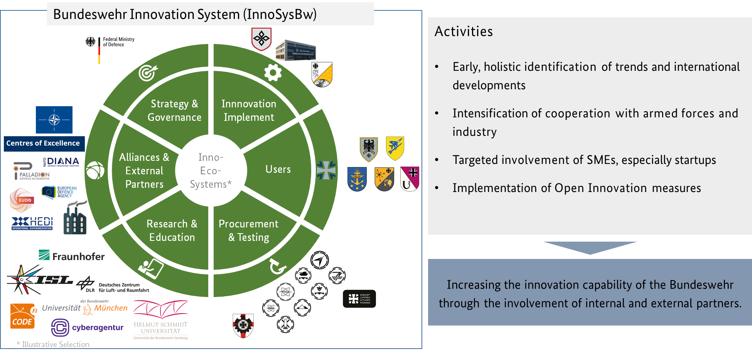
Innovation System (InnoSysBw)

Slide 17
Strengthening Cyber and IT Resilience across the Bundeswehr
DIRECTORATE-GENERAL INNOVATION AND CYBER
CDAO Defence UK
Captain (Navy) Daniel Prenzel,
Directorate-General for Innovation and Cyber
Policy, Planning and Procurement, Cyber and Information Systems Branch
27 January 2026

